Slide 1
S3. (SIMPLE STORAGE SERVICE)
Amazon S3: ESSENTIALS
➢
File and Object Storage
Unlimited Storage
High availability
99.999999999% Durability (Think of Disk set with RAID 1)
99.99% Availability (Spread across AZ’s)
Objects size can be from 1byte to 5TB
➢
Objects: Are static files
Contains Key and Value pair (meta data)
➢
Buckets: Contain a group of objects/files
Each bucket name must be unique across AWS S3
➢
Lifecycle Management
Archive or Delete Objects
➢
Versioning
preserve, retrieve, and restore every version of every object
➢
Encryption
Server-Side Encryption (S3 or KMS) or Client-Side Encryption
STORAGE TYPES
S3 TYPE | Standard | Standard - Infrequent Access | Reduced Redundancy Storage
Durability | 99.999999999% | 99.999999999% | 99.99%
Availability | 99.99% | 99.9% | 99.99%

Slide 2
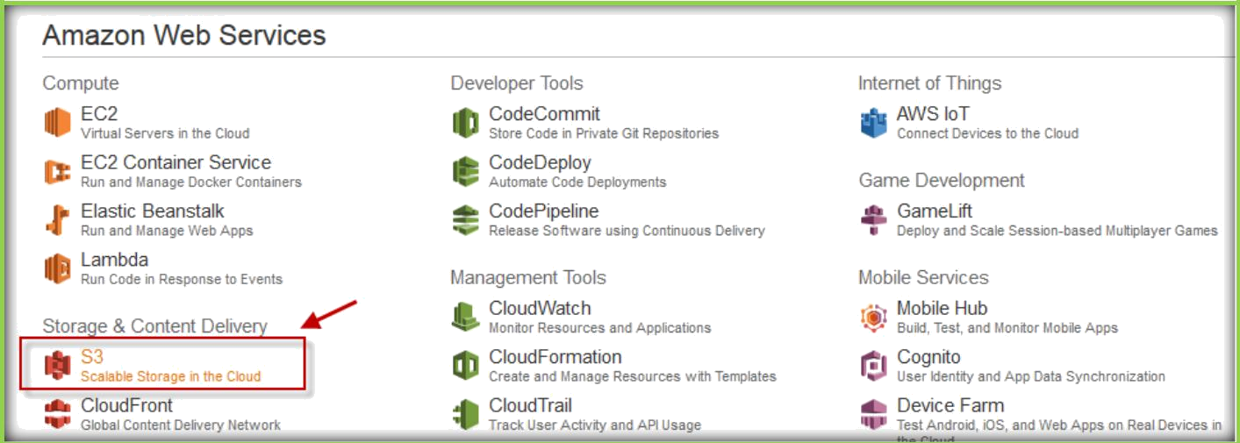
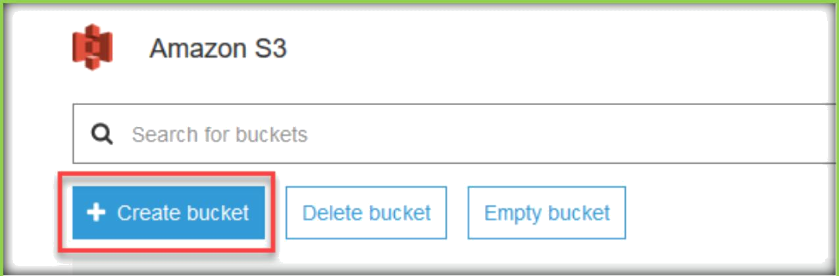
CREATE S3 BUCKET
Once you logged in to AWS console, choose S3 under Storage & Content Delivery From Management Console.
Click on Create Bucket to create a new one.
Then give a name for the S3 bucket and choose the region, in which region you want to place this bucket.

Slide 3
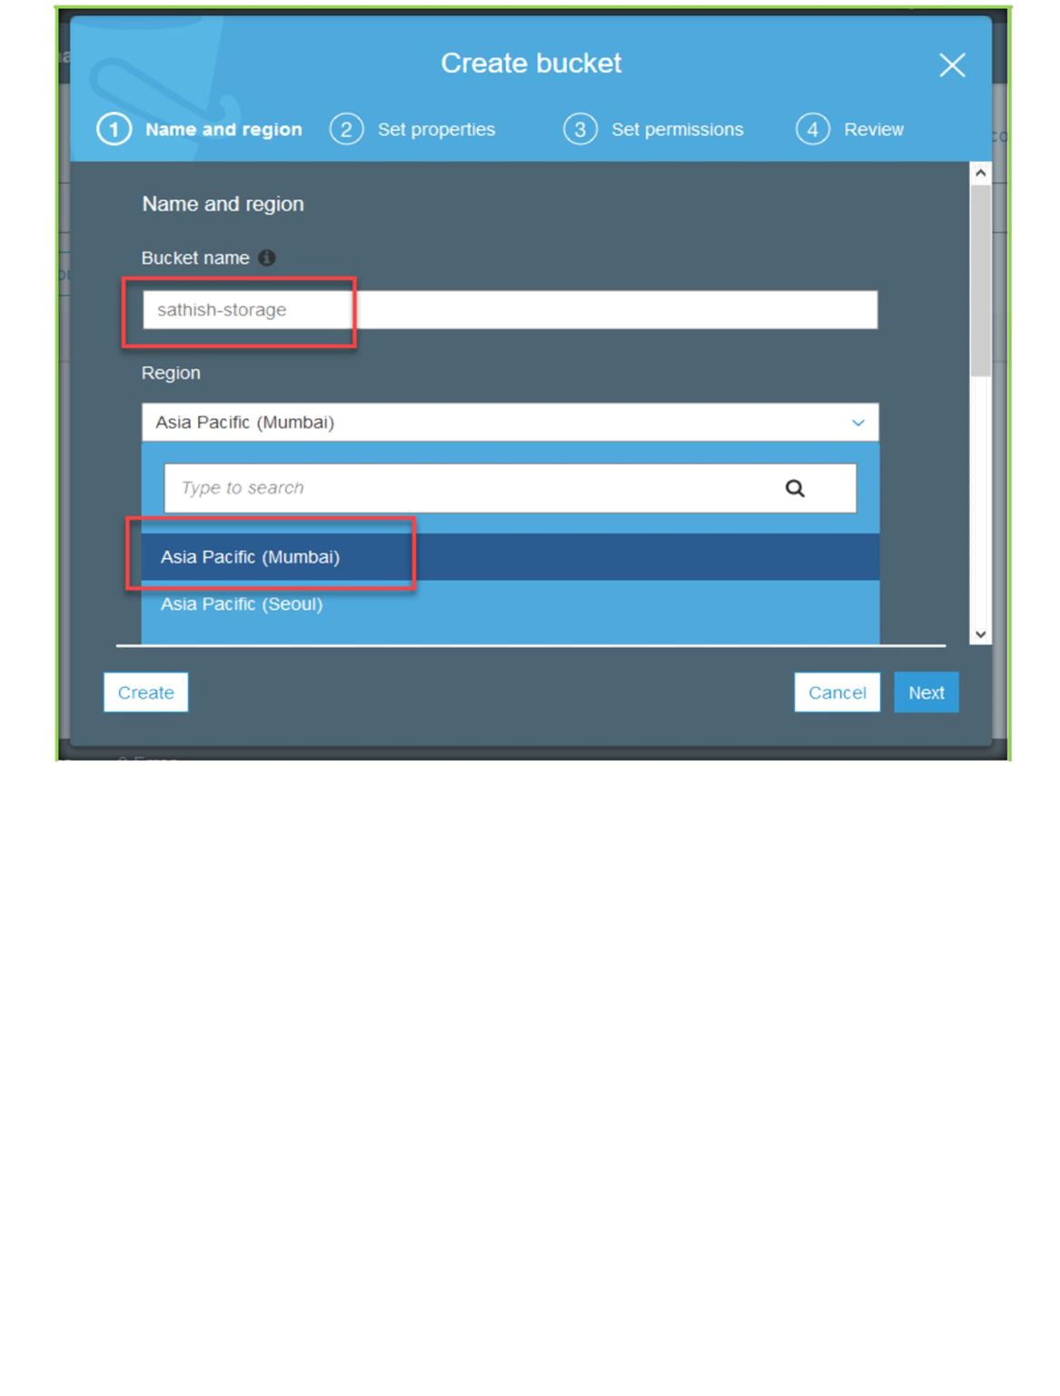
Then choose Next to continue with bucket creation process.

Slide 4
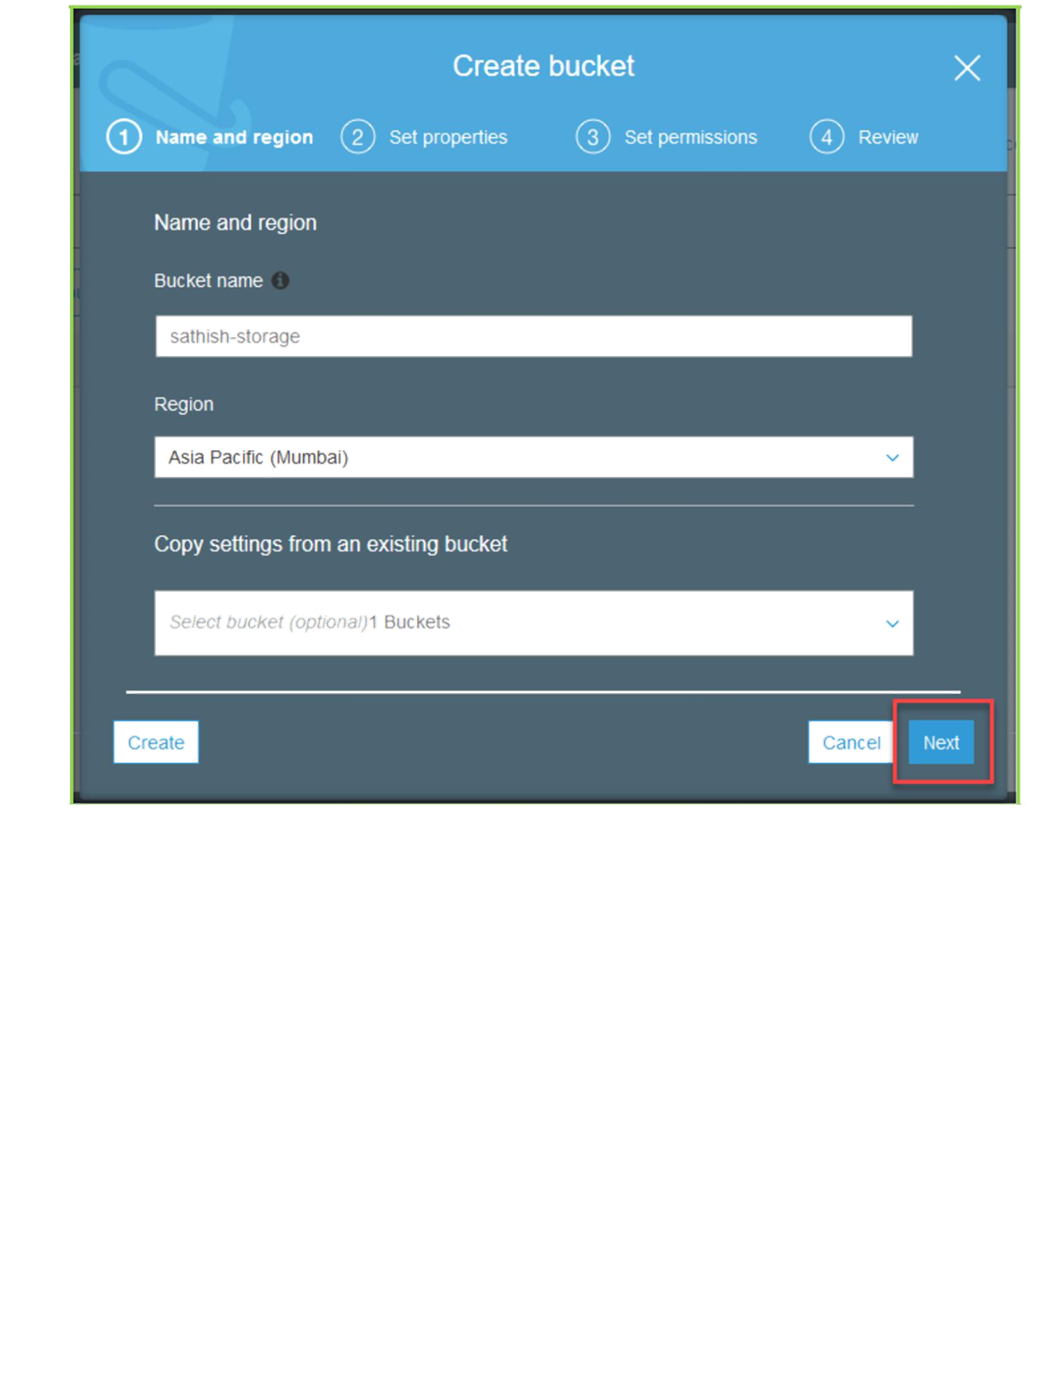
Choose Next here again.

Slide 5
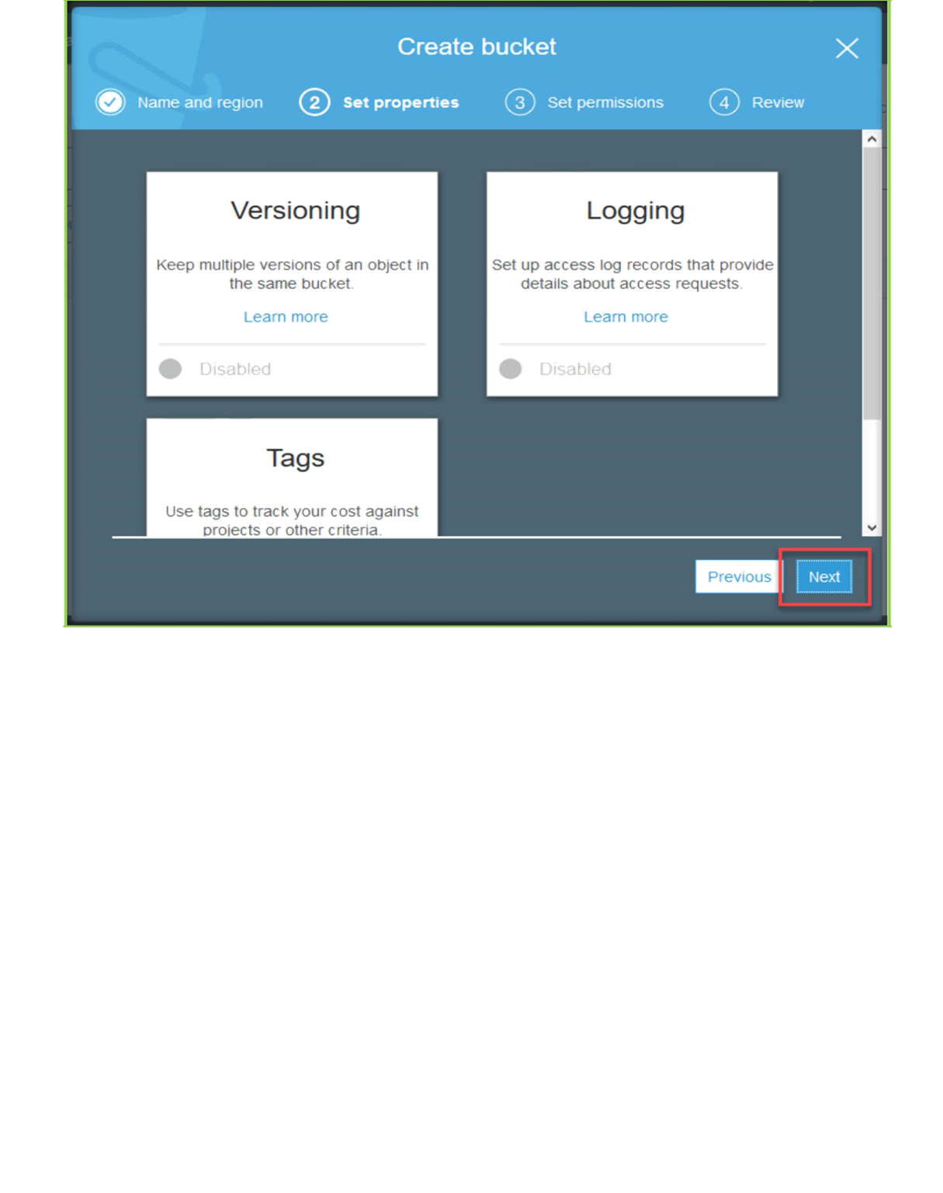
Choose Next here again.

Slide 6
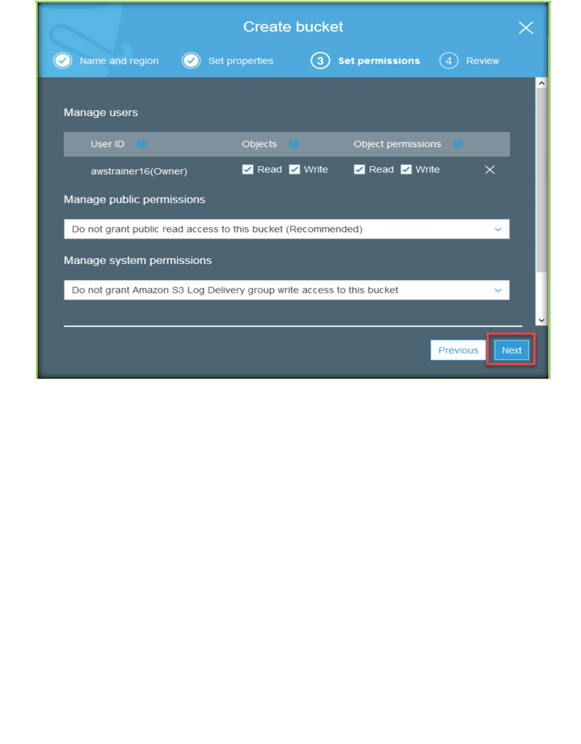
Choose create bucket to complete the creation process.

Slide 7
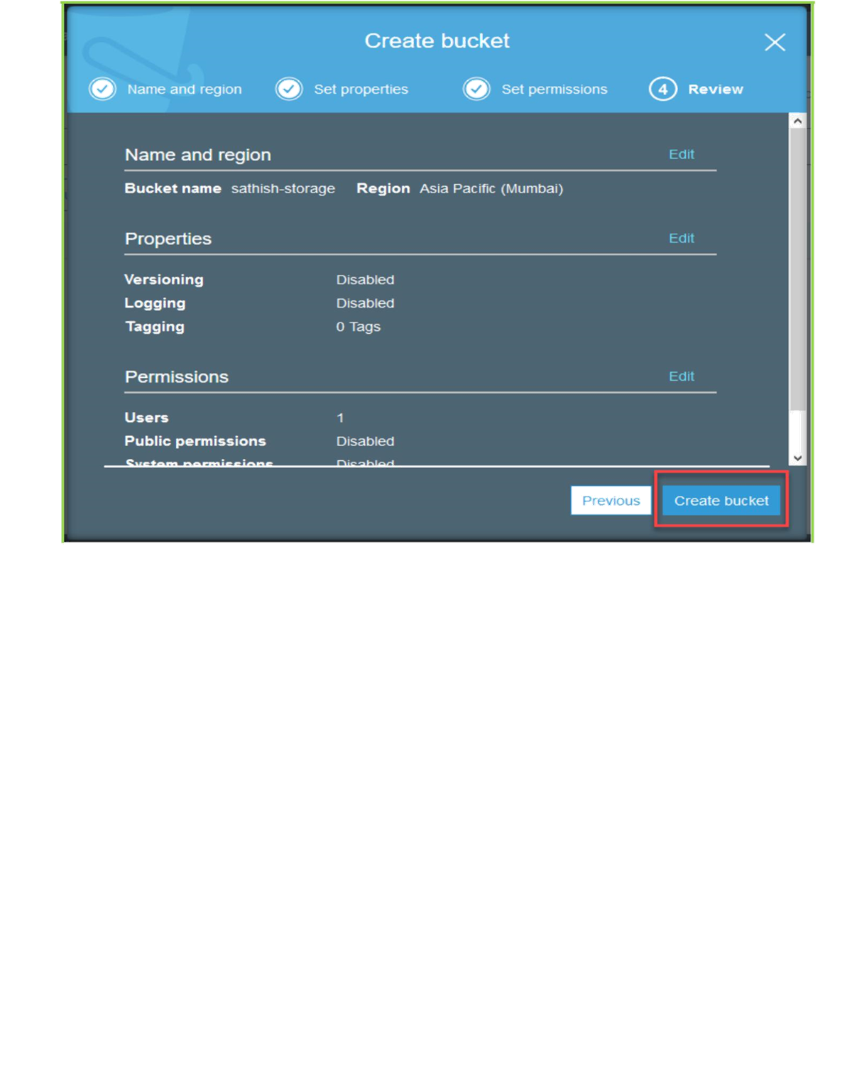
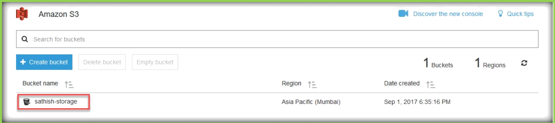
Now you can see the bucket in the buckets list.

Slide 8
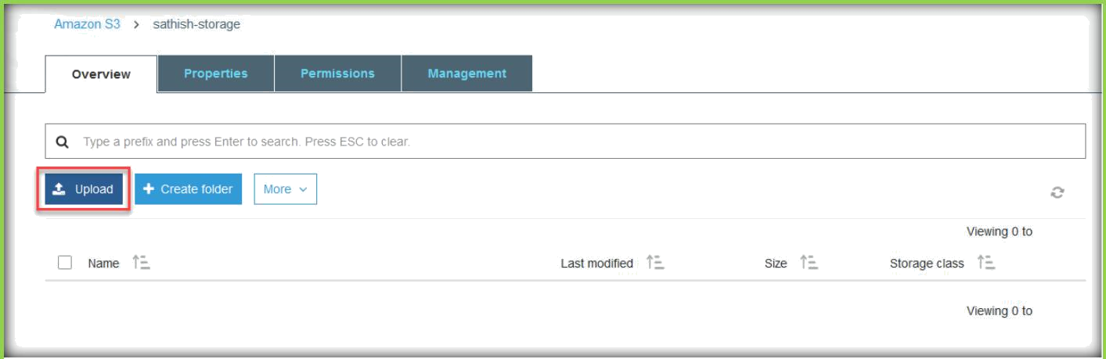
When you click on the newly created Bucket, you will go inside of the bucket, then choose upload to upload the data to the bucket.
Next, choose add files.

Slide 9
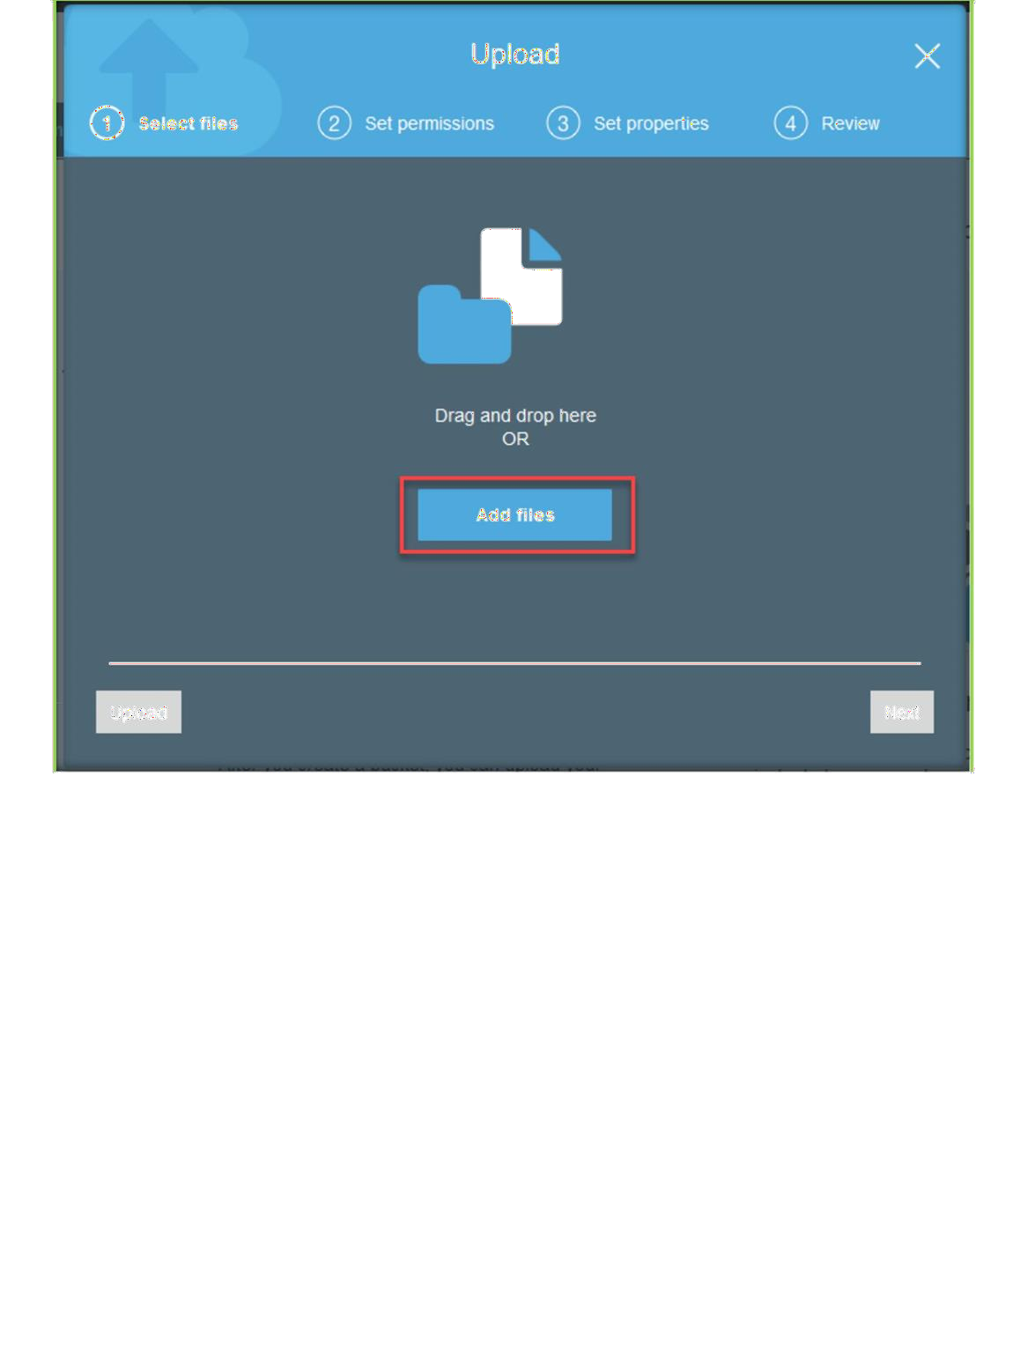
Then choose the files, you can choose multiple files to upload multiple files.

Slide 10
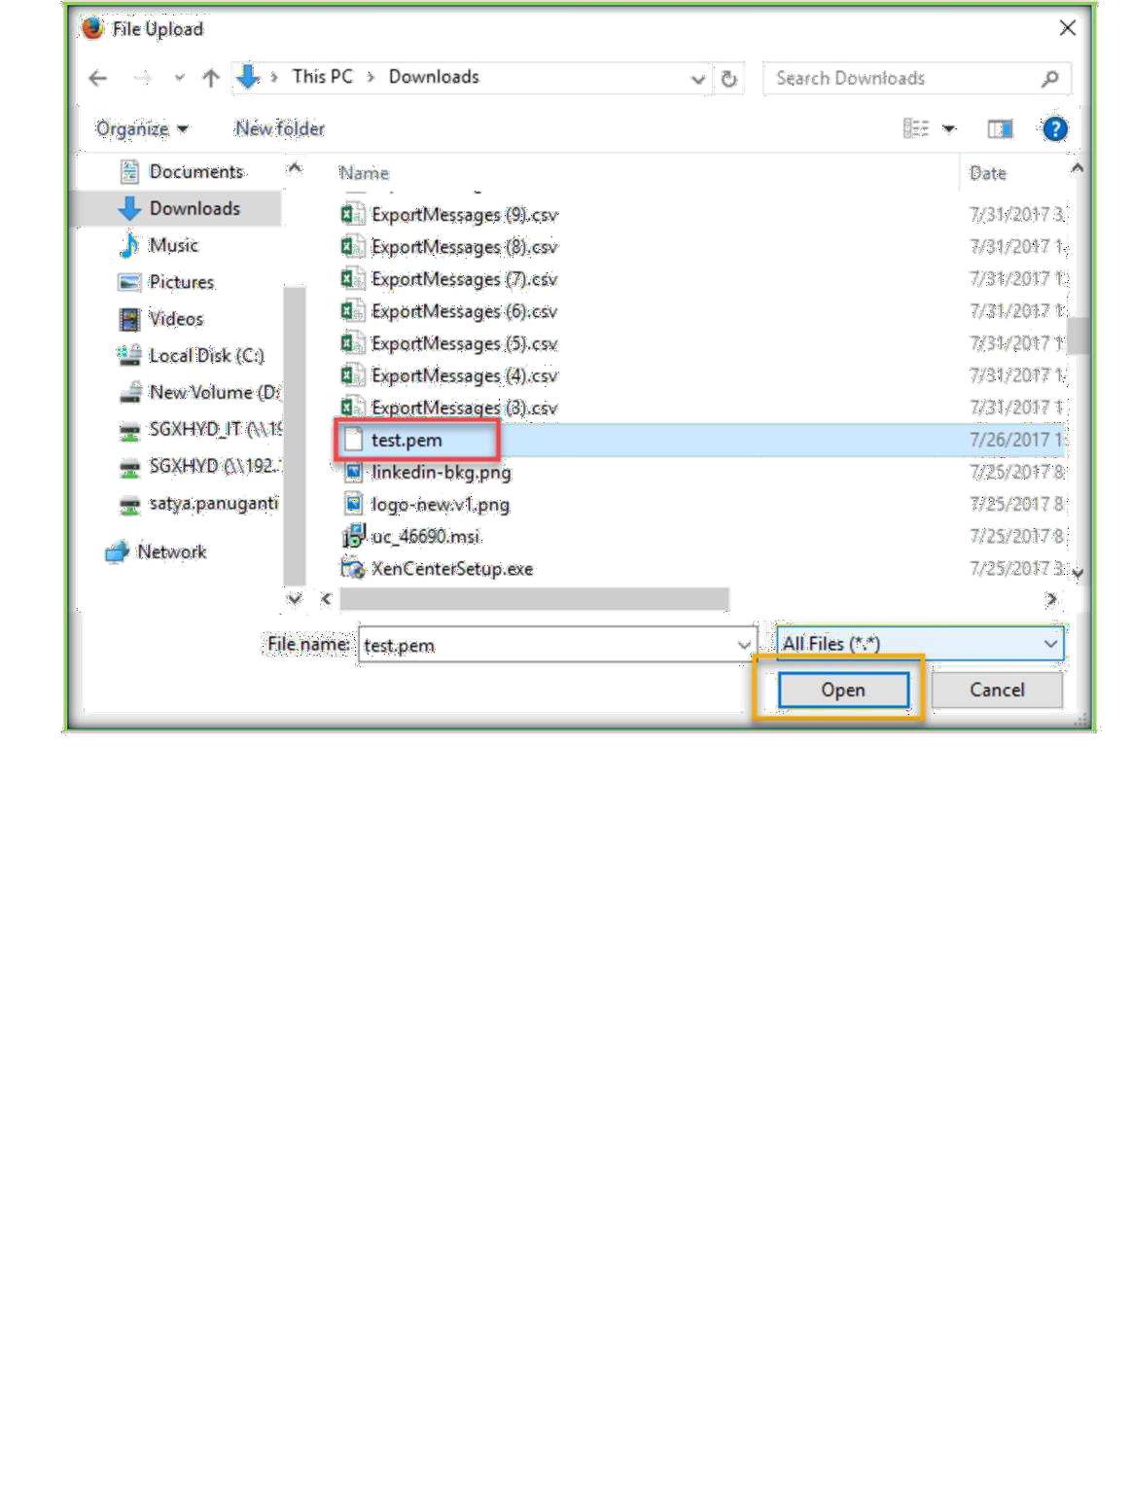
Then choose next.

Slide 11
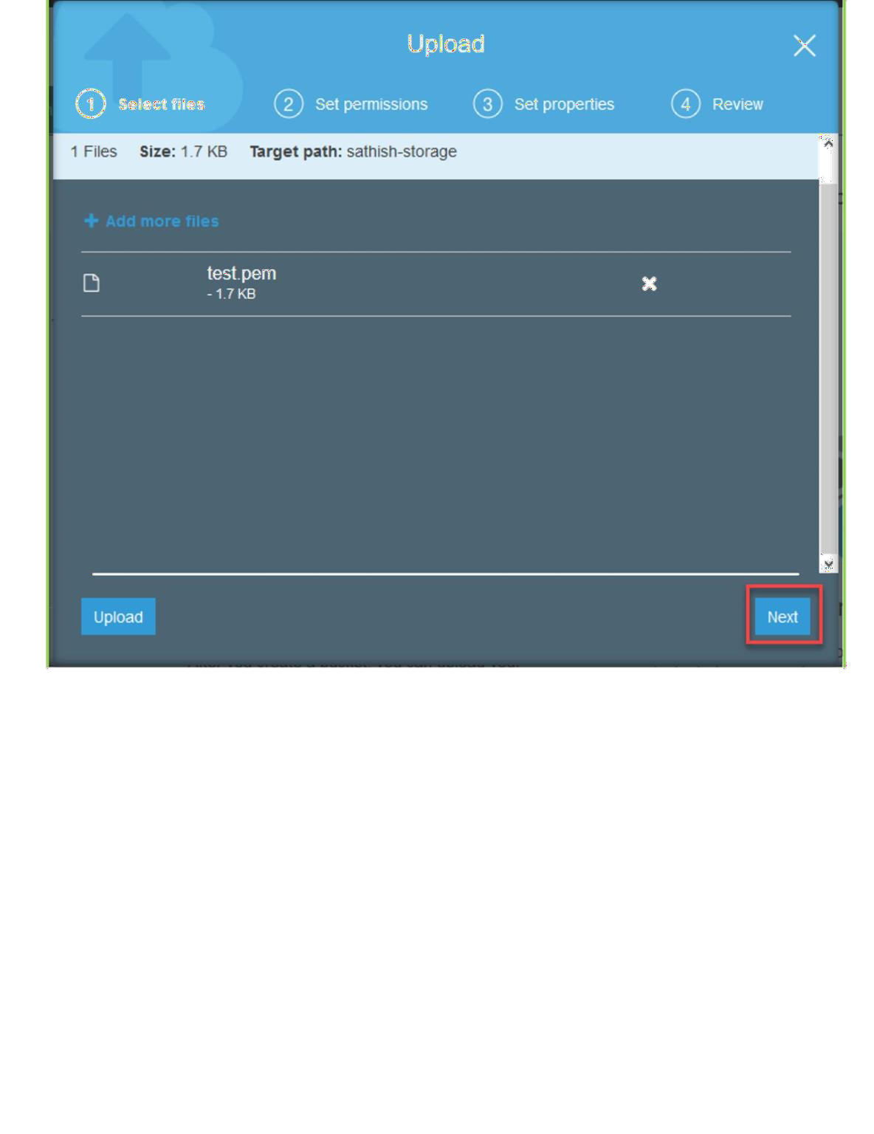
Choose next again.

Slide 12
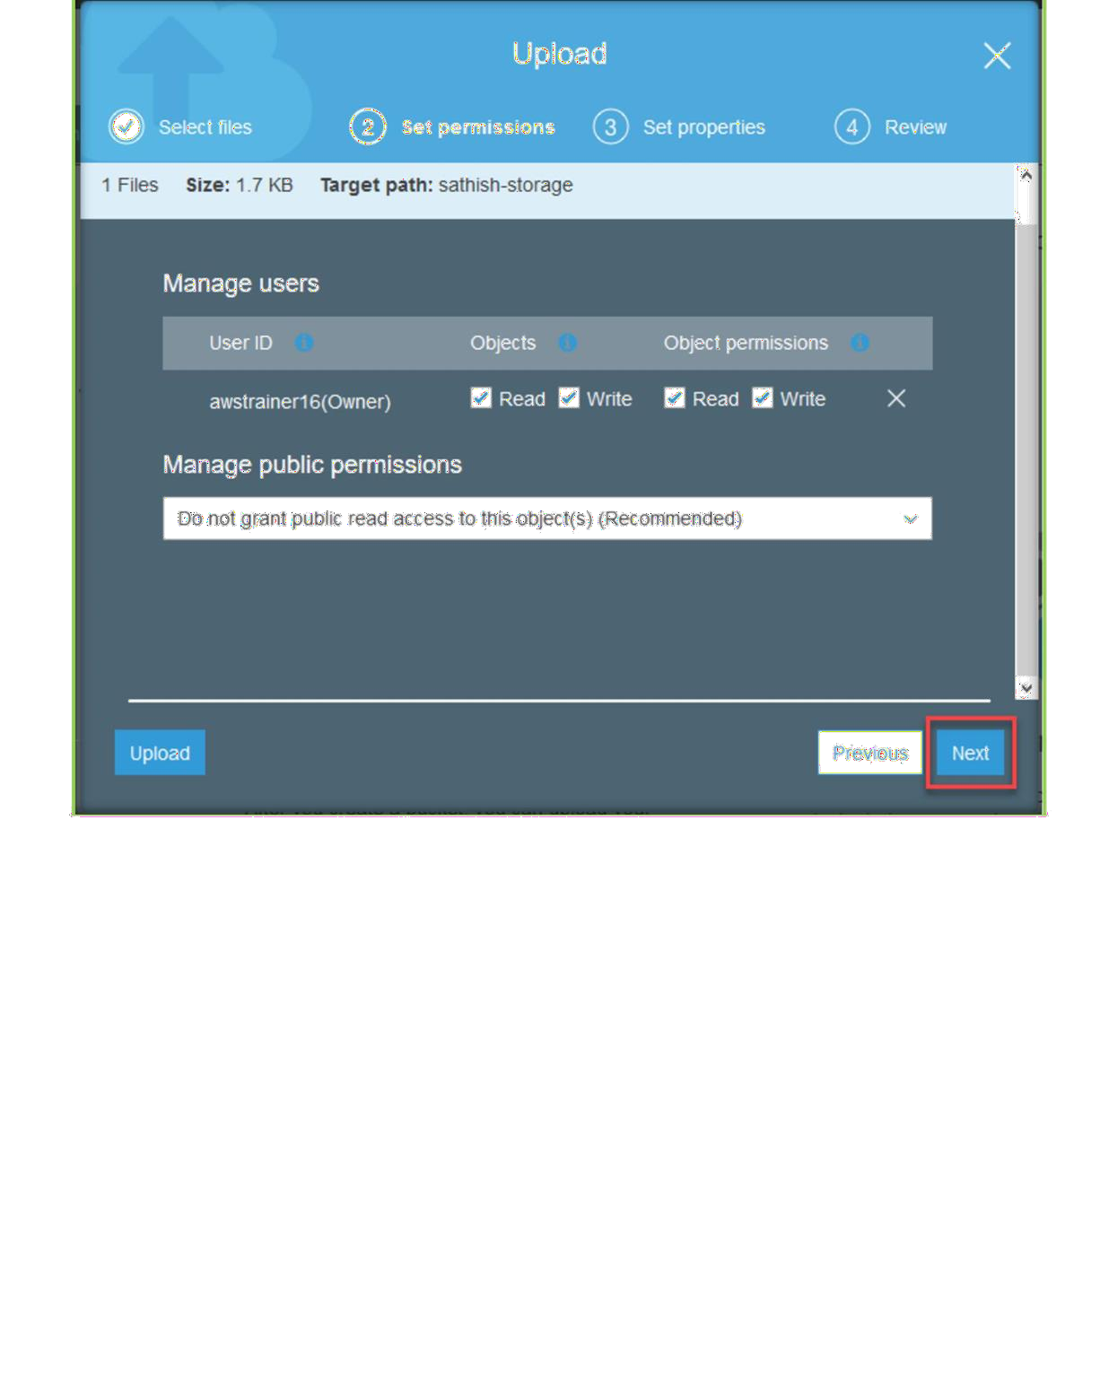
Choose storage type and encryption then click on Next.

Slide 13
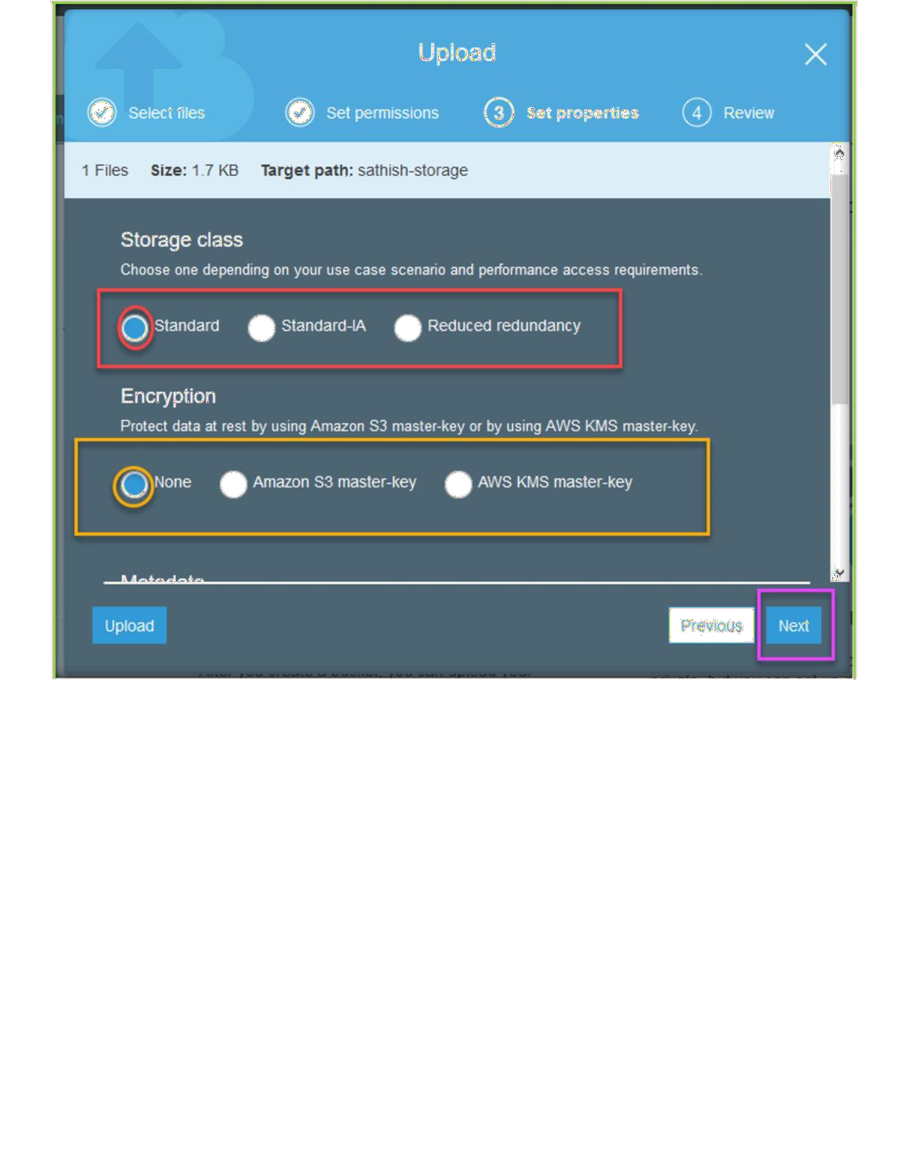
Finally click upload to complete upload process.

Slide 14
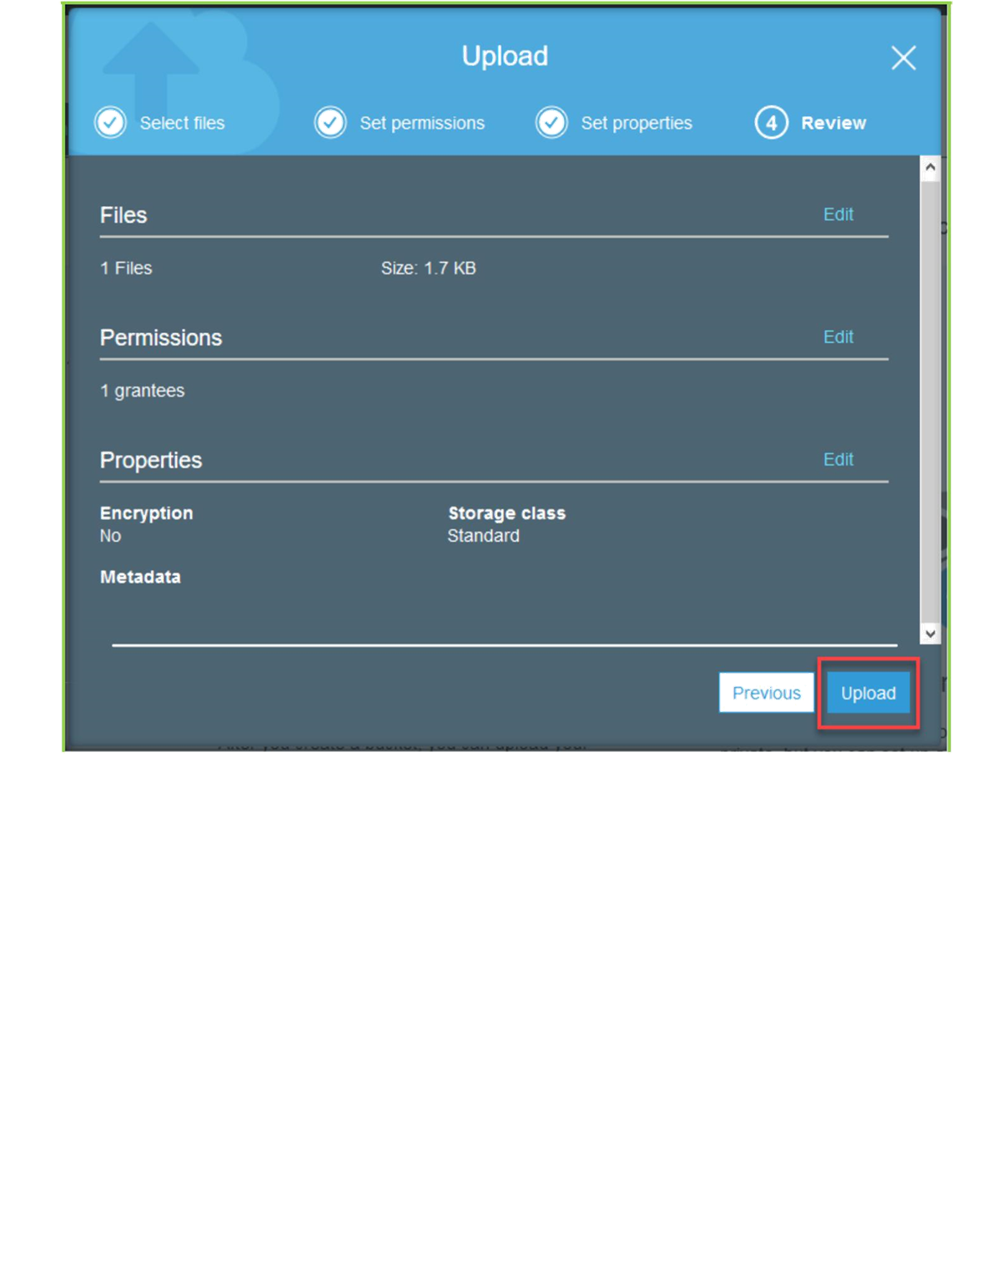
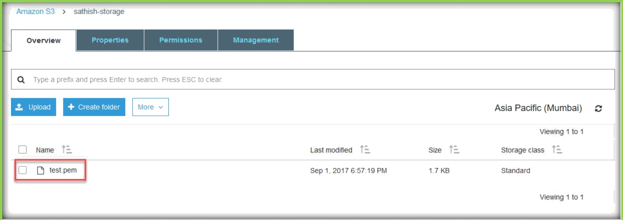
Once done, uploaded files will be in the list.

Slide 15
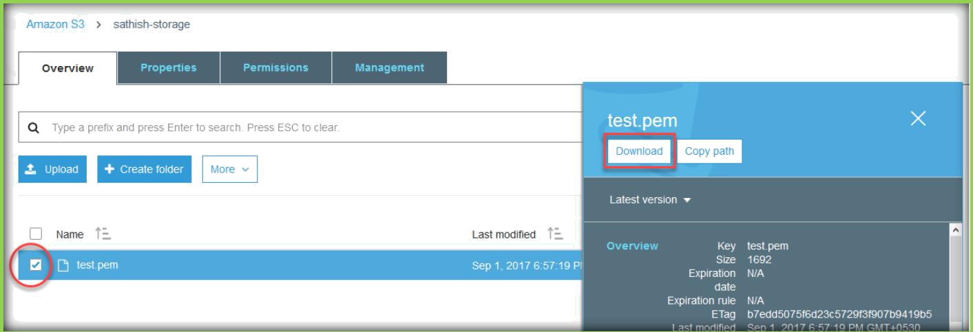
HOSTING A WEBSITE ON S3
If you want to download the files which you upload, choose the file, a popup windows on left side of the page will come just click on Download to download the file.
Once you created a bucket, create a html file with following code and name that file as index.html and upload to created bucket.
<html>
<body>
<h1 style="color:blue;">This is for testing S3</h1>
</body>
</html>
Once you uploaded, go inside of the bucket choose Properties from top menu and then choose Static Website Hosting.

Slide 16
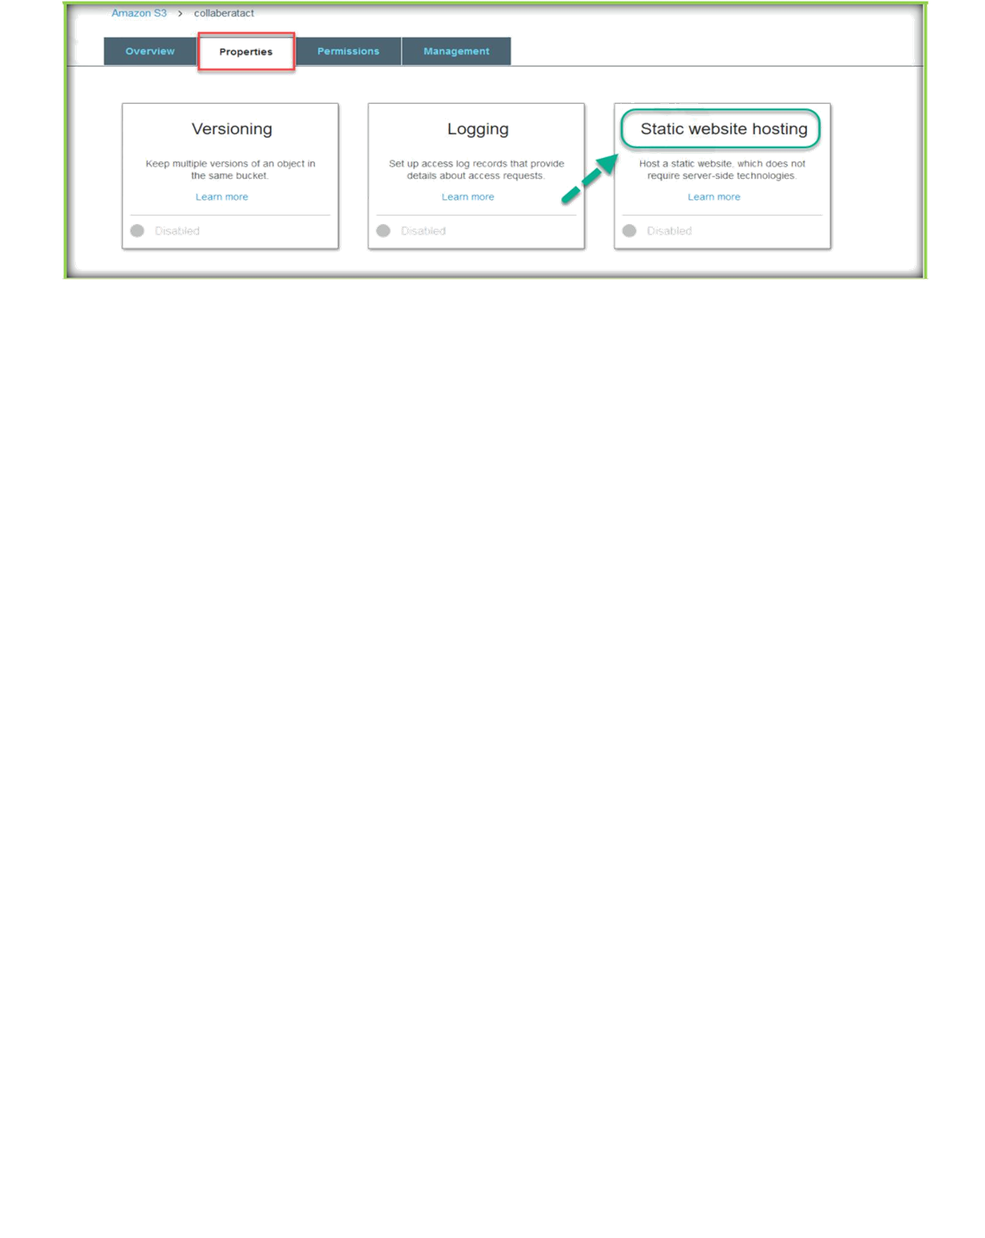
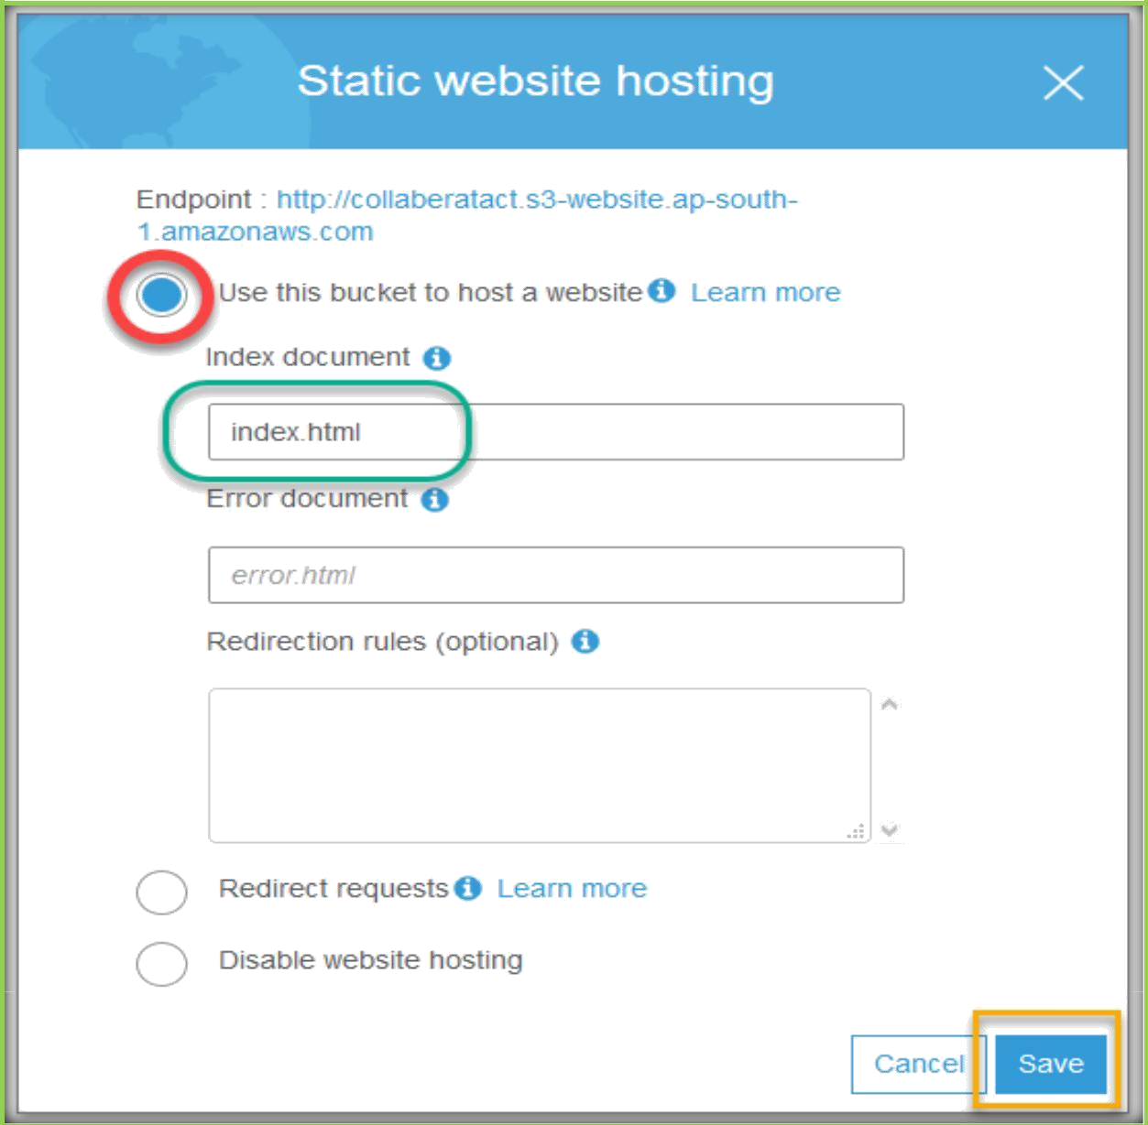
Choose Use this bucket to host a website, specify index.html under index document text field. Then choose save button.

Slide 17
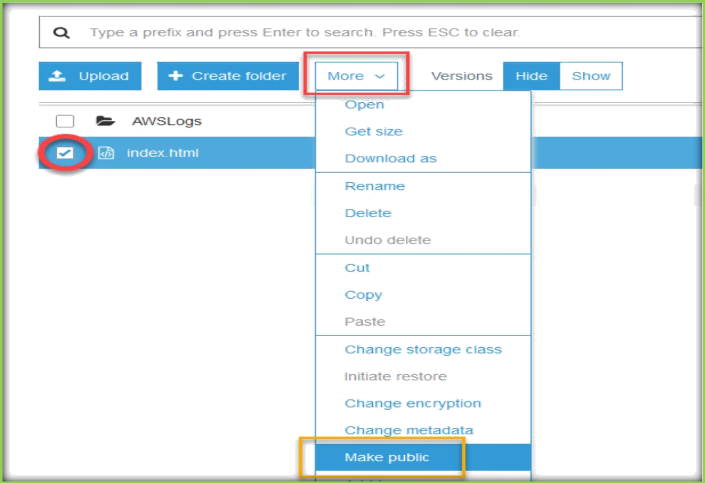
Then choose overview from top menu, then select the index.html file which we uploaded earlier, file select Make Public under More tab.
A pop up window will open to confirm, choose Make public to confirm.

Slide 18
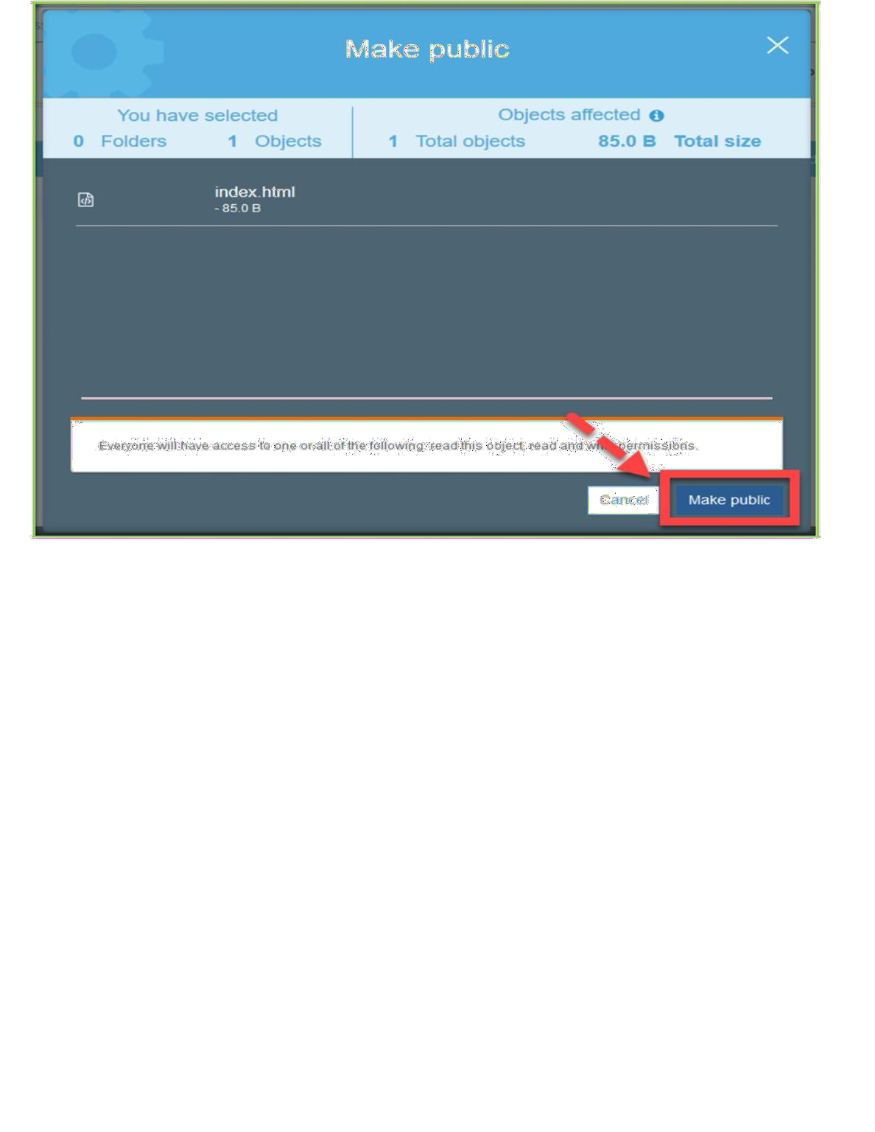
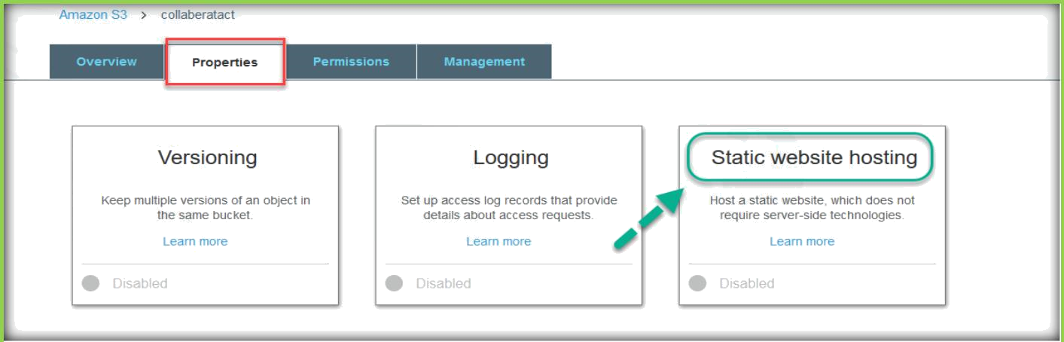
Then choose Properties from top menu and then choose Static Website Hosting.
Then copy the Endpoint and open in a browser to see website which we hosted on S3.

Slide 19
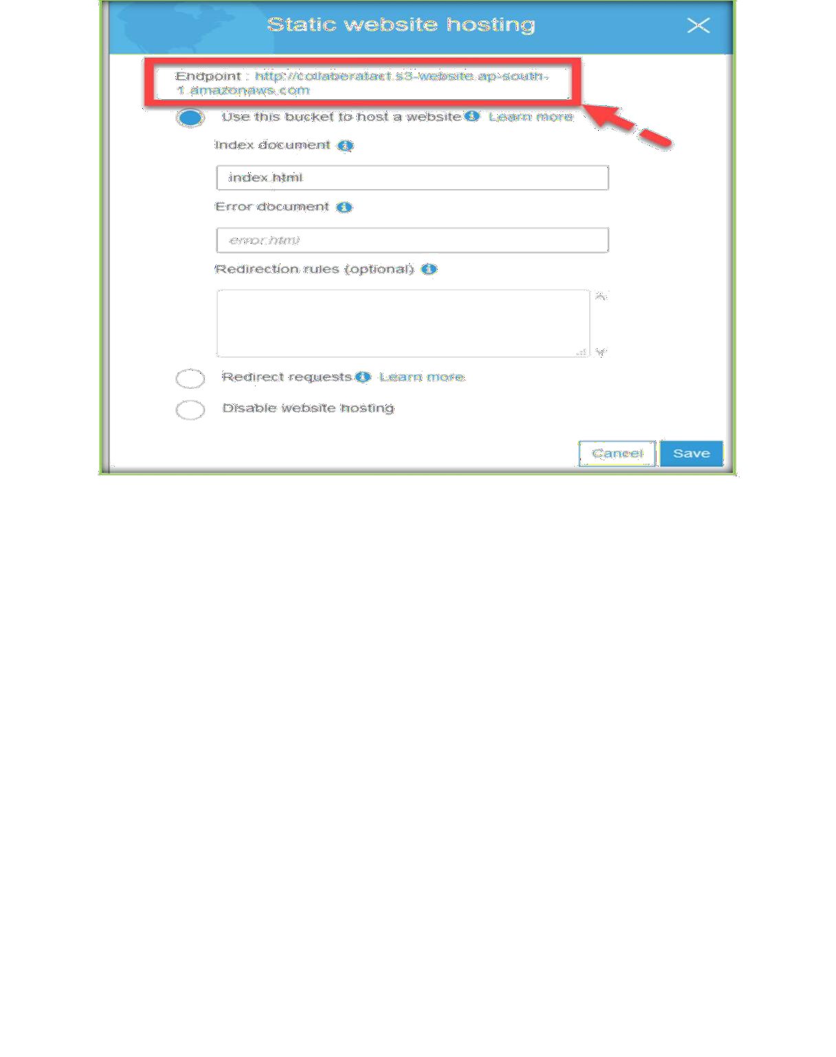
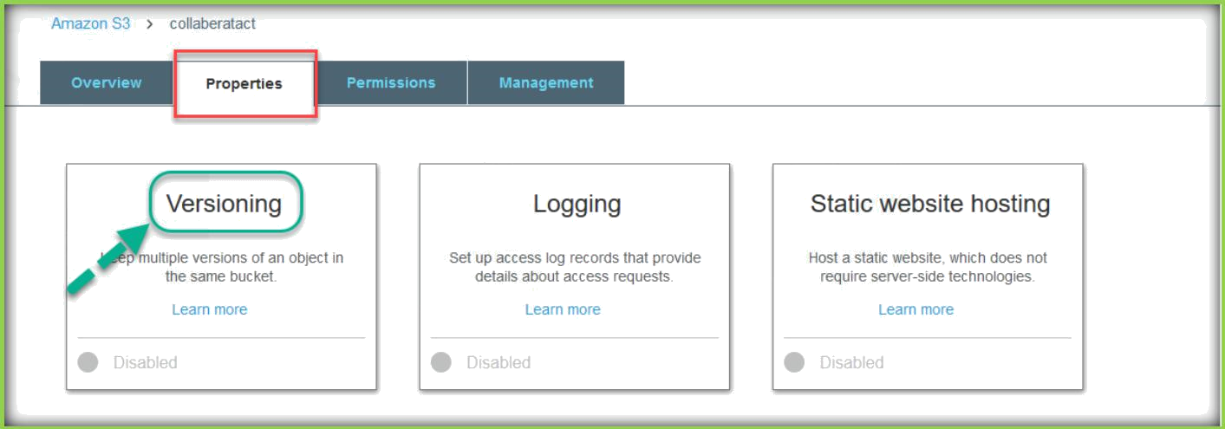
S3 OBJECT VERSIONING
Under S3, go in to the Bucket, choose Properties of the Bucket. Under Properties, click on Versioning.

Slide 20
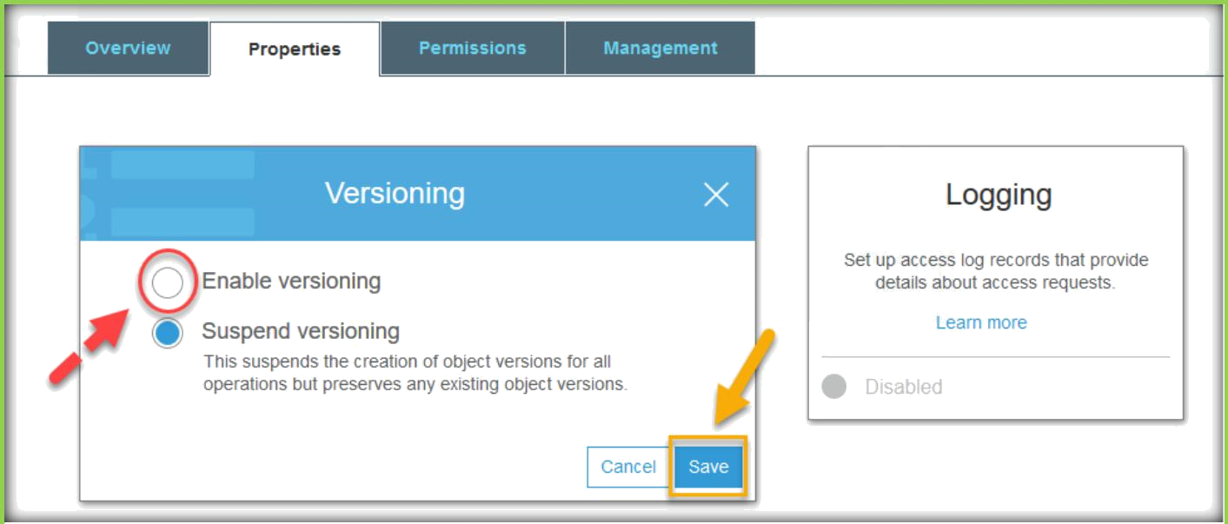
A pop up dialog box will open, choose Enable versioning, then choose save.
Add below code to existing index.html file and upload it to same bucket.
<html>
<body>
<h1 style="color:blue;">This is for testing S3 Versioning</h1>
<h2 style="color:green;">Hi Welcome to S3 Versioning</h2>
</body>
</html>
Now right click on the file and choose open to see the updated changes.

Slide 21
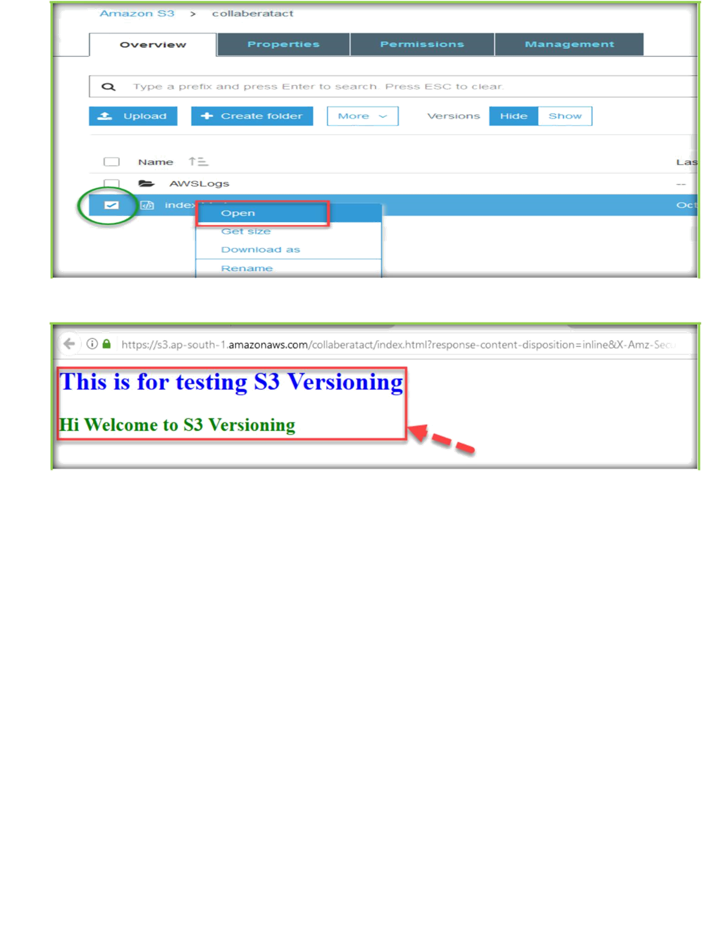
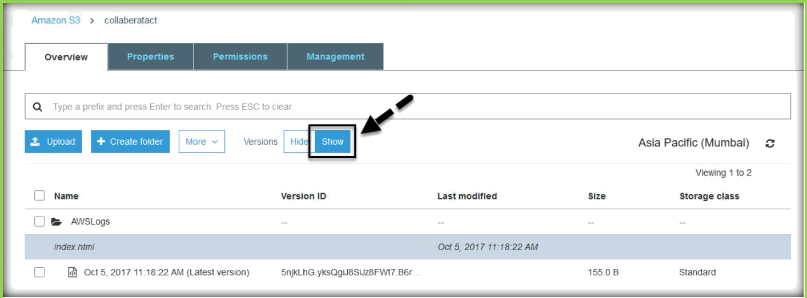
Once enabled versioning, you can see a Versions tab will display beside of the Actions tab.
Choose Show to see the versions of current file.

Slide 22
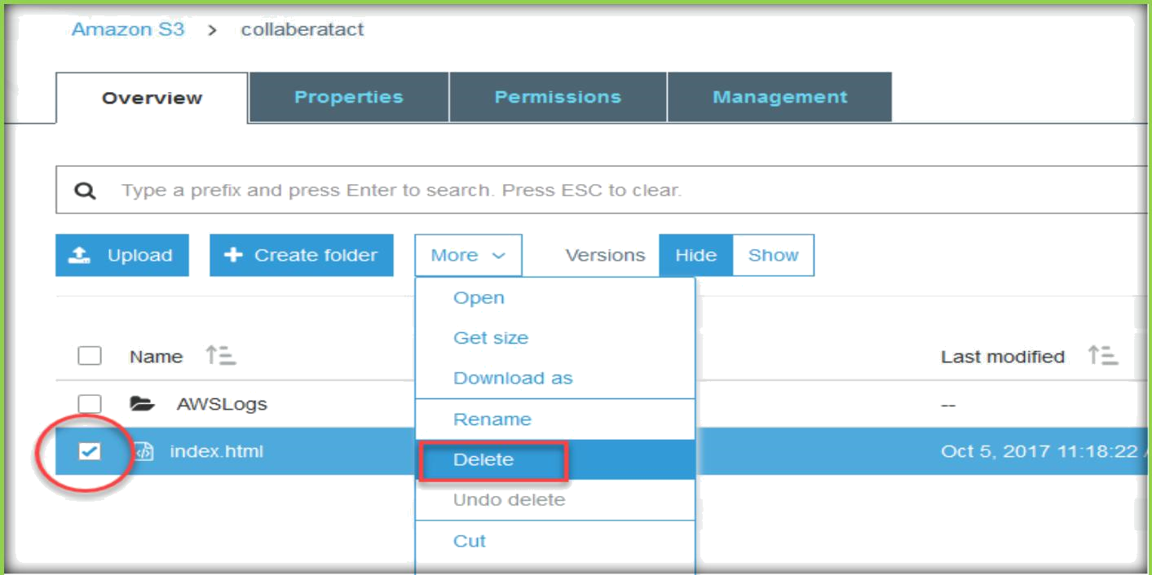
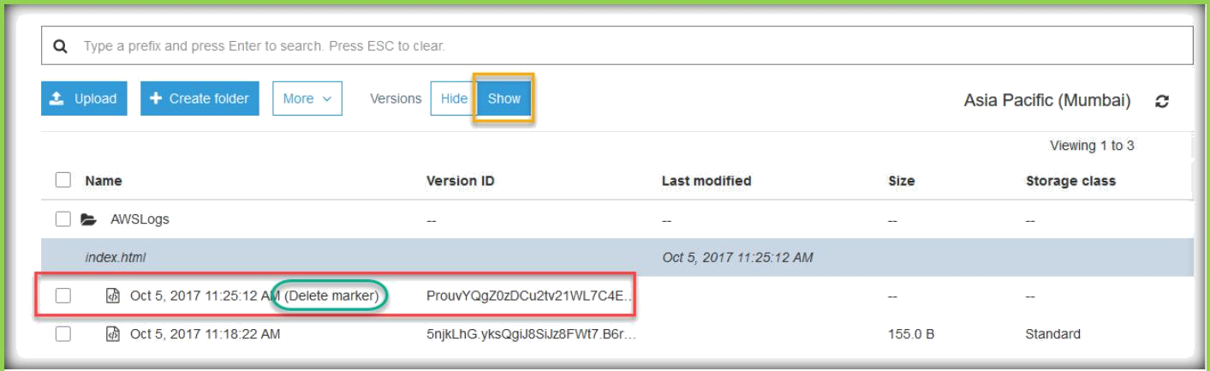
Choose index.html under the Bucket, click on Delete under more tab to remove the current version of the object.
Click on Show option for Versions to see the available versions.
You can be able to see file has been deleted and added Delete marker to the file.
You choose the file which has delete marker and choose delete from the more tab.

Slide 23
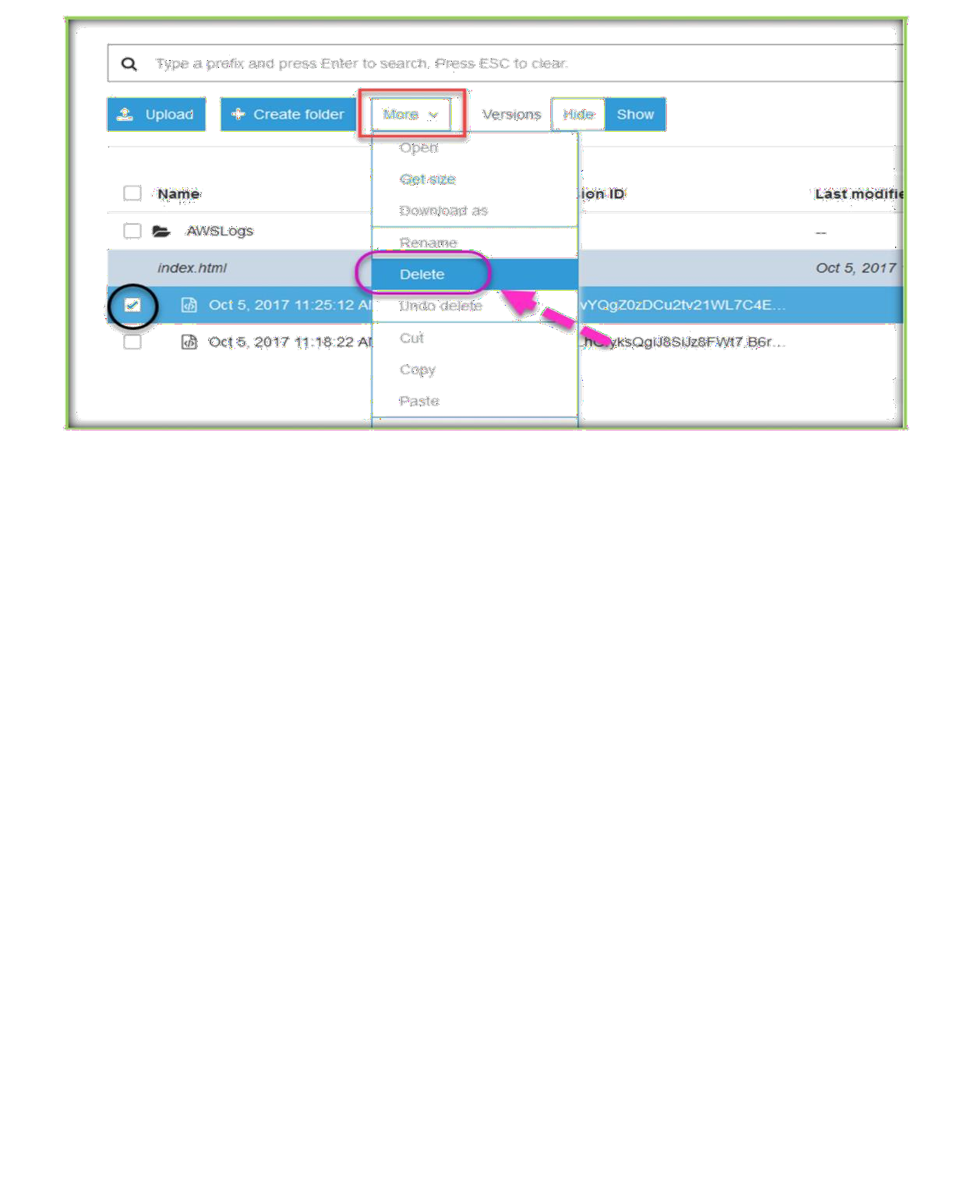
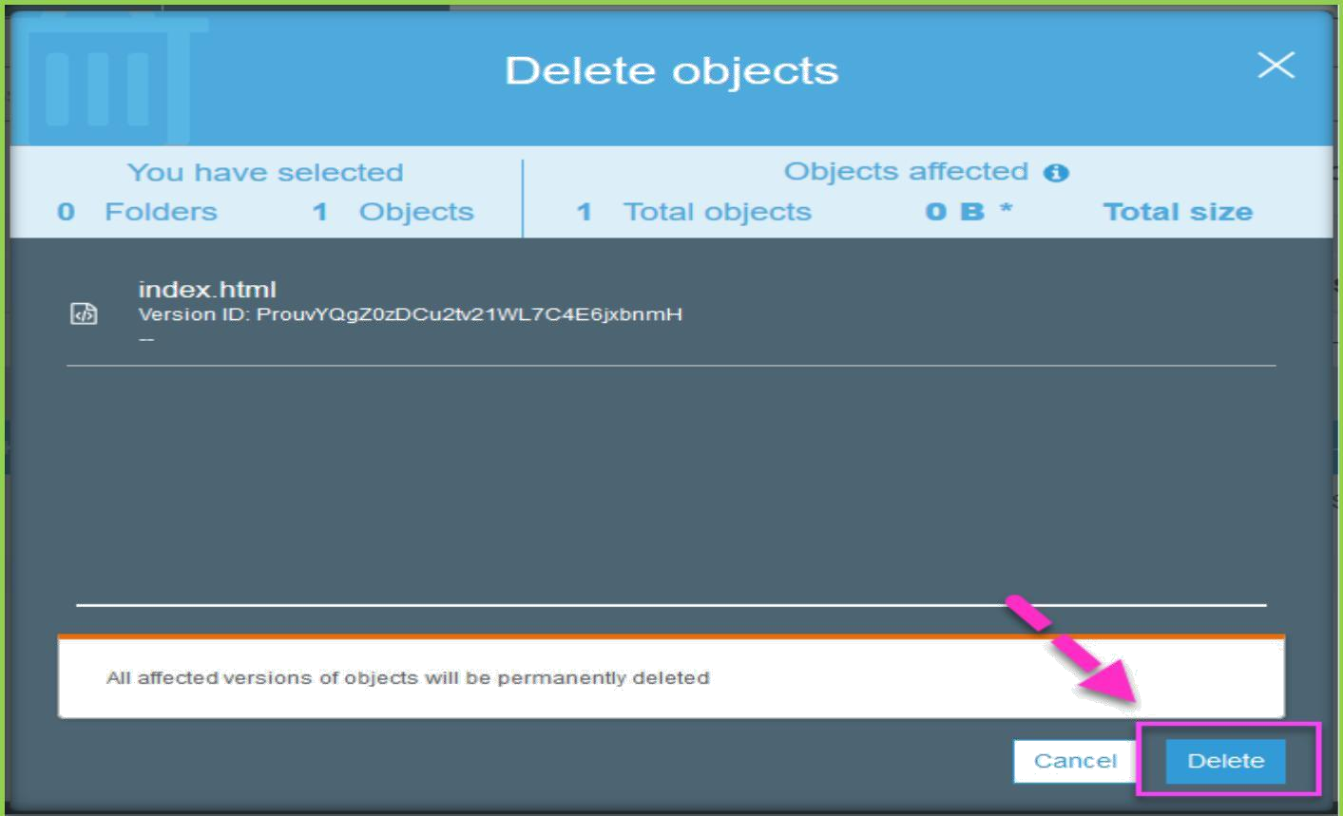
Confirm deletion of delete marker.

Slide 24
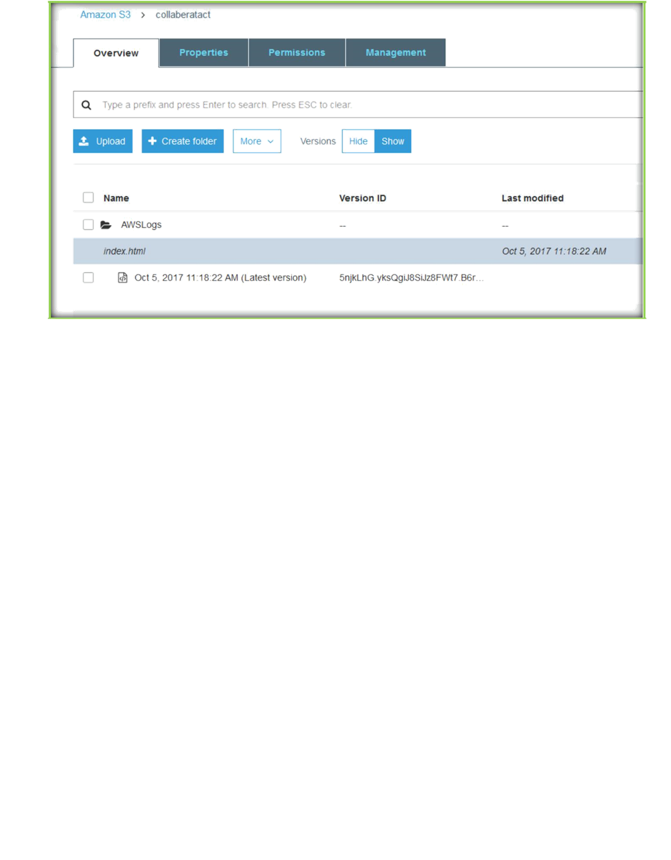
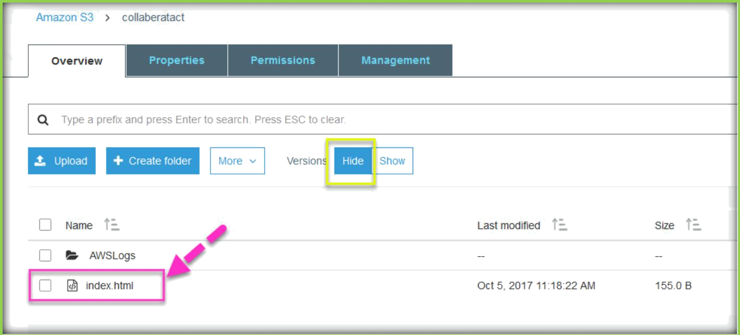
You can be able to see the file has been restored back.
To suspend versioning on the Bucket, go to properties of the Bucket, click on Versioning, under versioning choose Suspend Versioning.

Slide 25
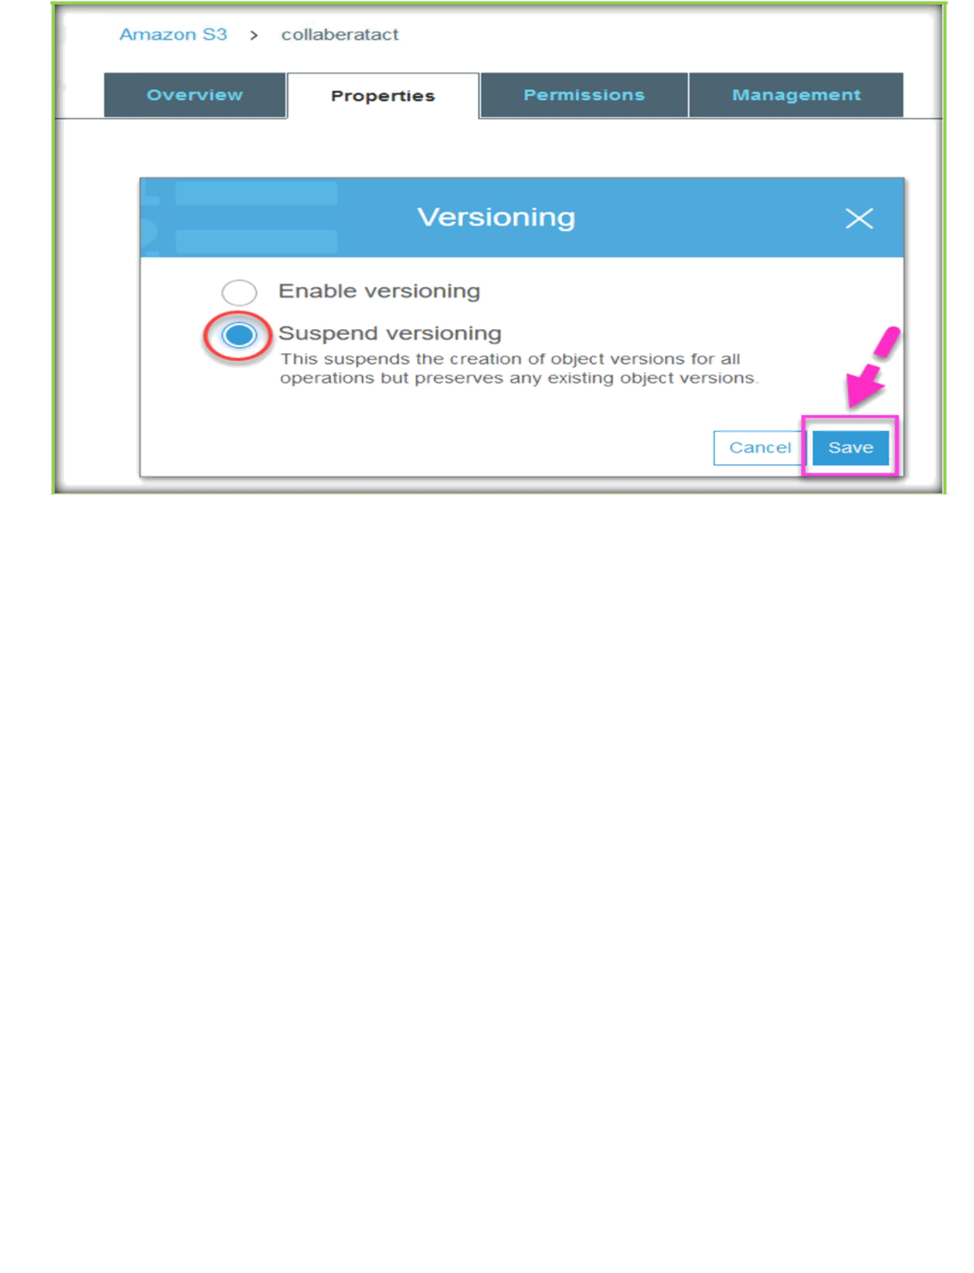
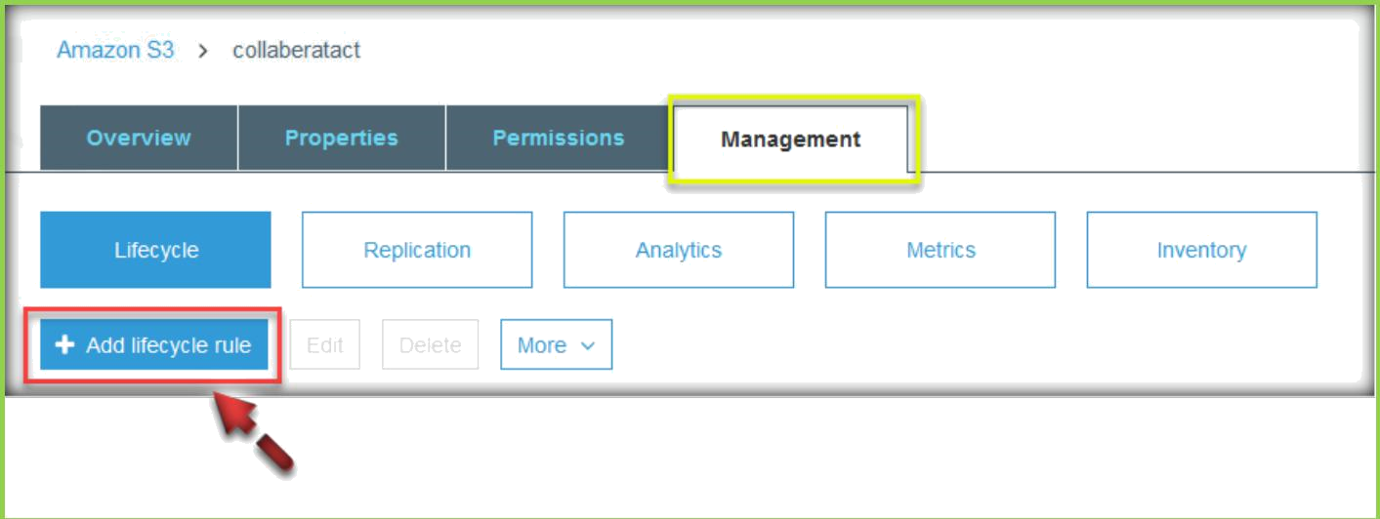
S3 LIFECYCLE POLICIES
Expand Lifecycle under bucket properties, then click on Add rule.
Go in to the bucket, choose Management them click on Add lifecycle rule below the lifecycle.

Slide 26
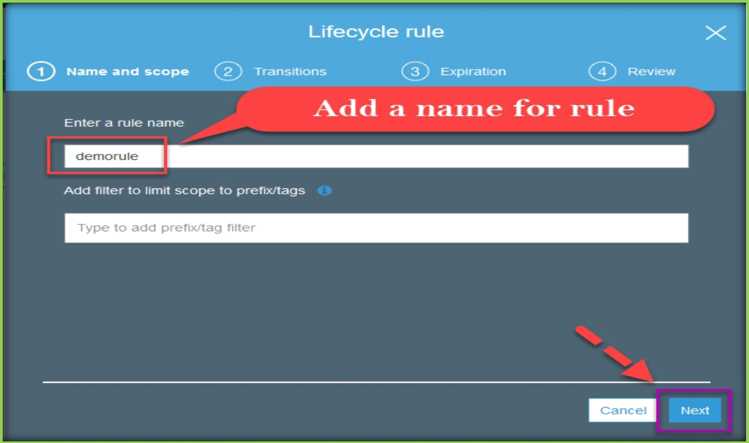
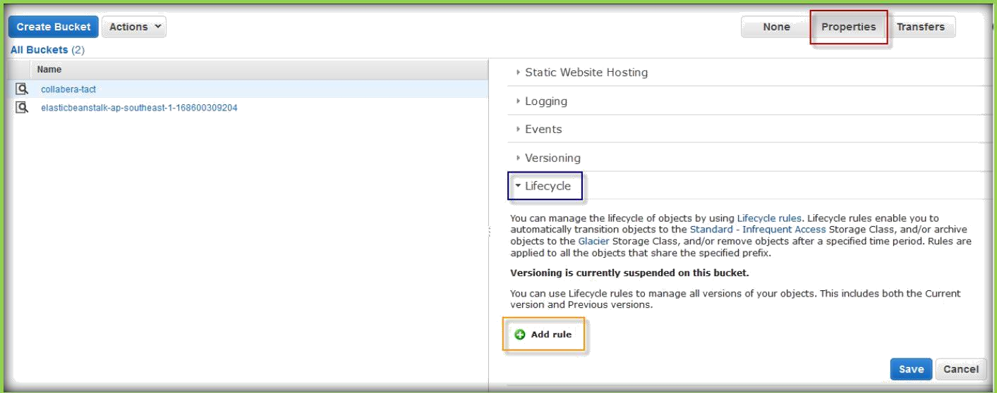
Then add a name for rule and choose Next.

Slide 27
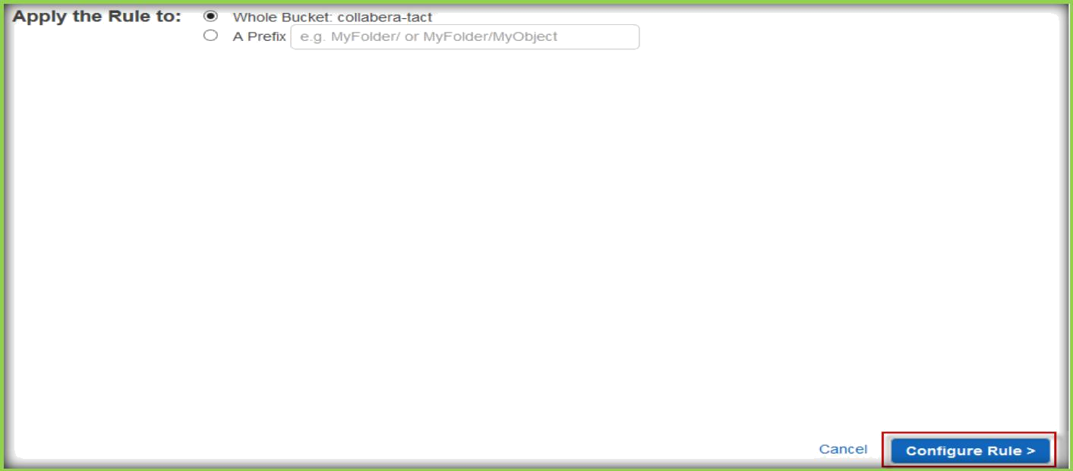
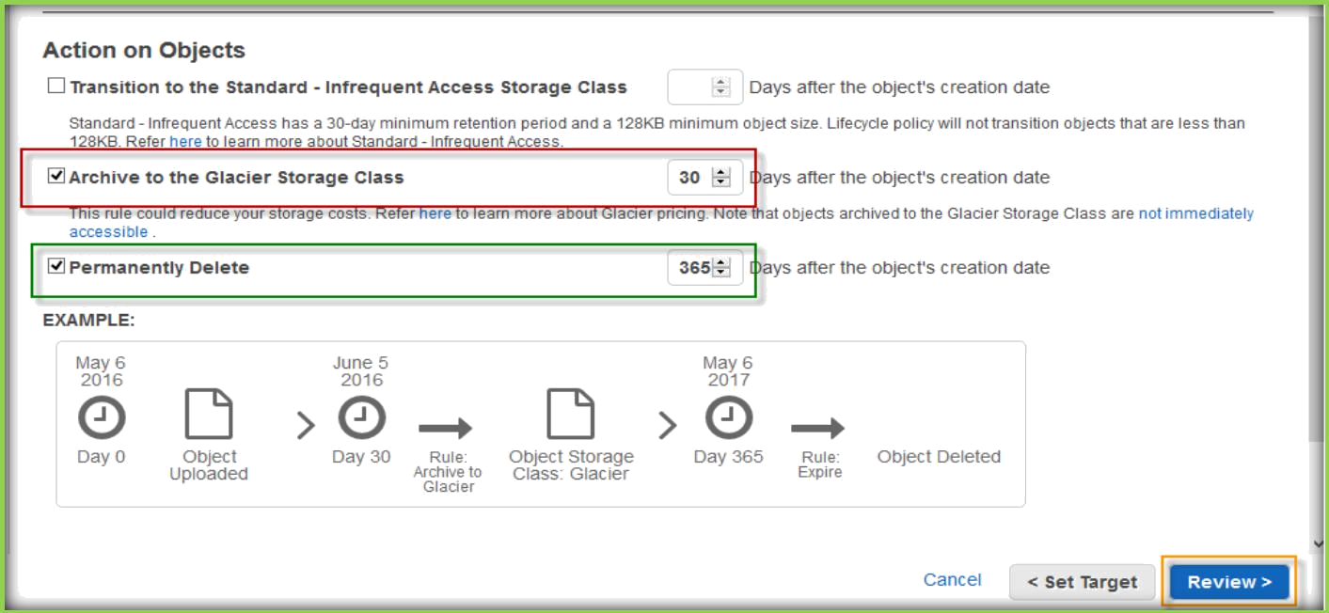
Specify you want to create lifecycle for whole Bucket or for specific folder, then choose Configure Rule.
Now choose the options to how you want your objects to be moved over to glacier or Standard Infrequent Access storage or permanently deleted.
Select the lifecycle policy and specify the days where object needs to be moved over or deleted.
Then choose Review.

Slide 28
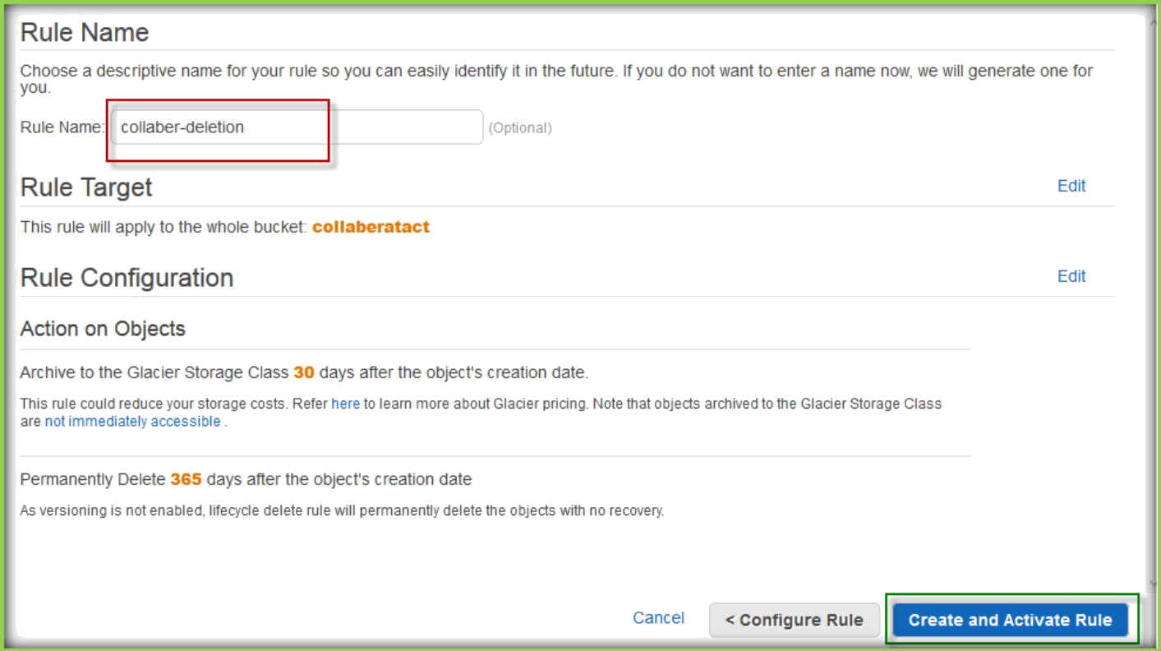
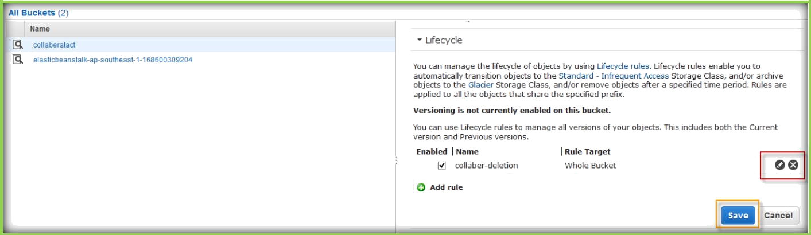
Then specify a rule name under Rule Name text field and choose Create and Activate Rule.
Under lifecycle policies choose cross mark against the rule and click save to delete the rule which you created.

Slide 29
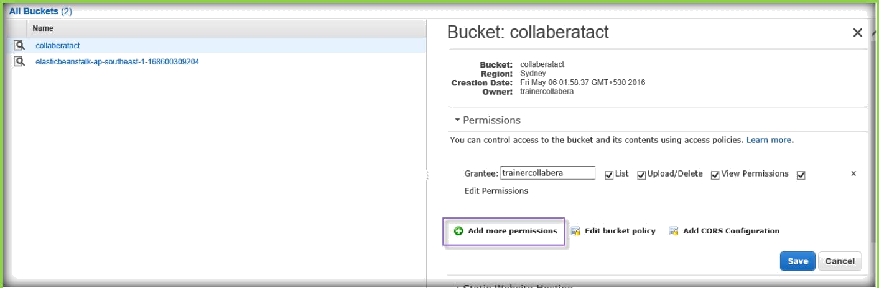
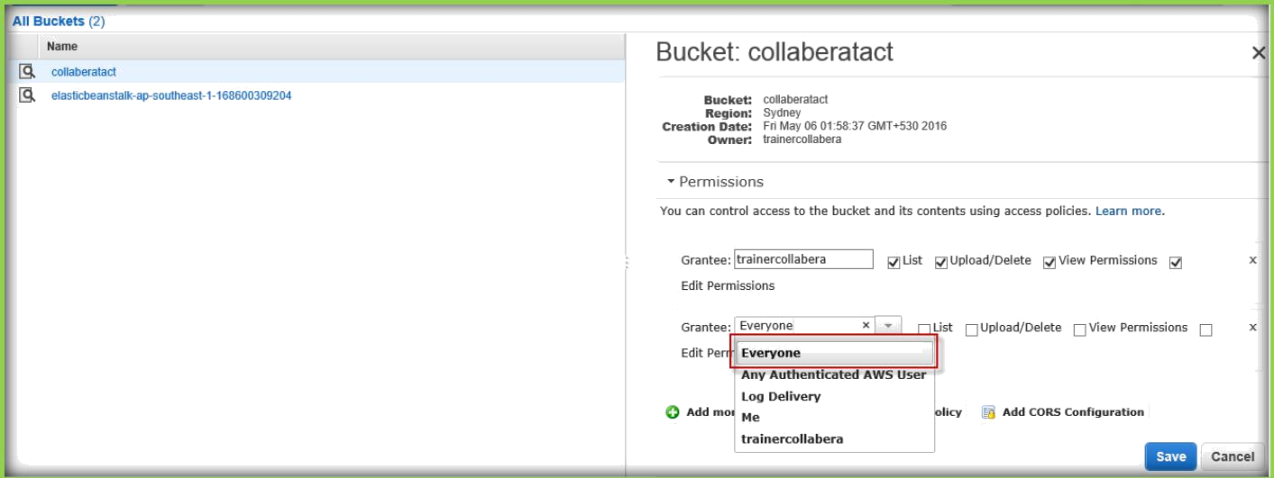
S3 PERMISSIONS AND BUCKET POLICIES
Go to properties of your bucket and under properties expand permissions. Then choose Add more permissions.
Under Grantee choose option for your permission.
Then check permissions which you want to give for particular grantee, and choose save to apply the policy permission.

Slide 30
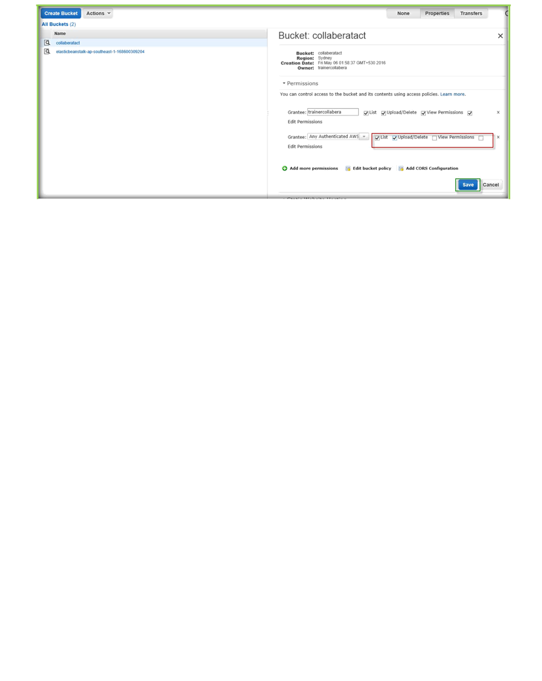
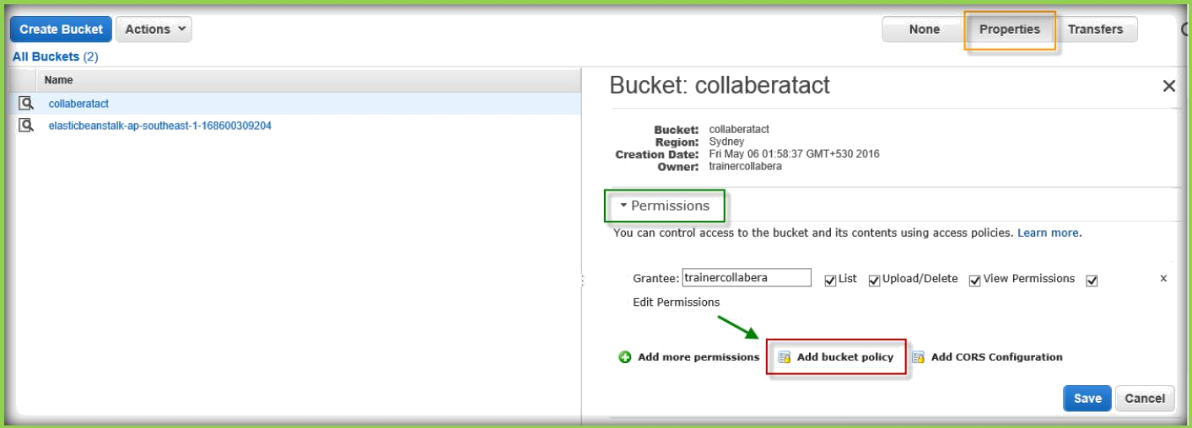
S3 BUCKET POLICIES:
Go to properties of your bucket and under properties expand permissions, then choose Add bucket policy to add a new policy to bucket.
Bucket policy Editor text will be opened, then choose AWS Policy Generator.

Slide 31
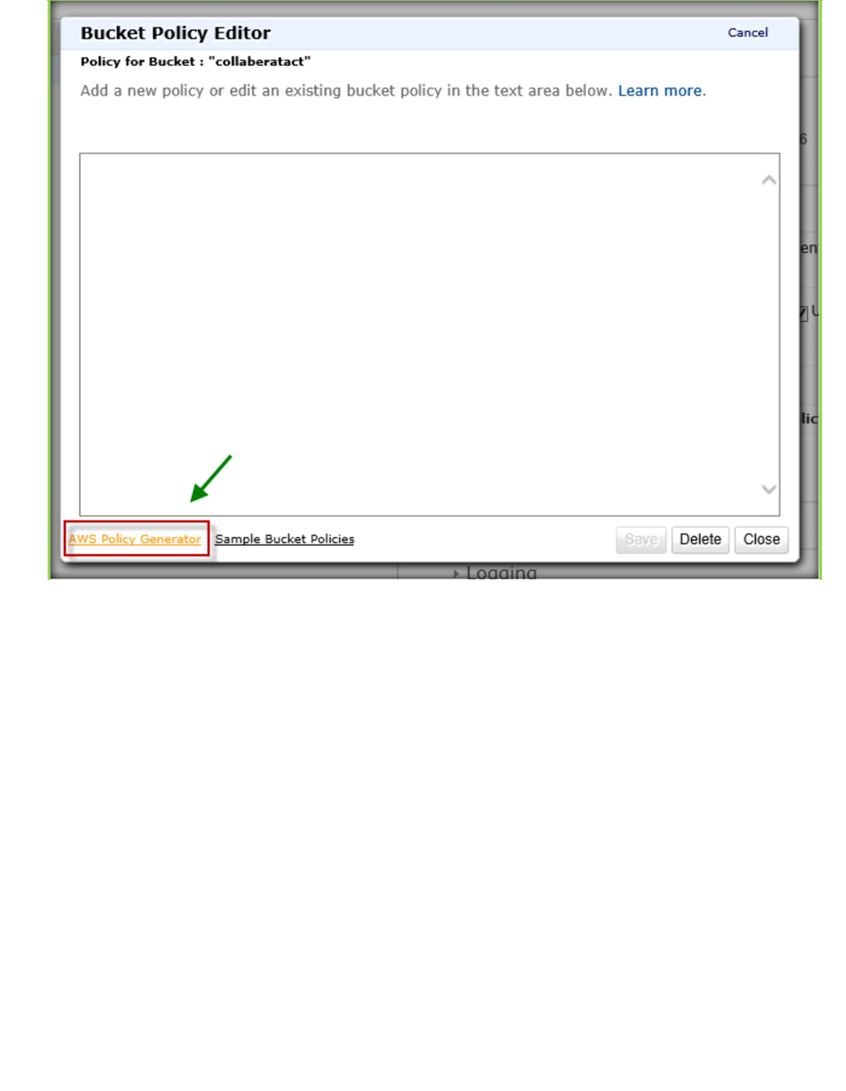
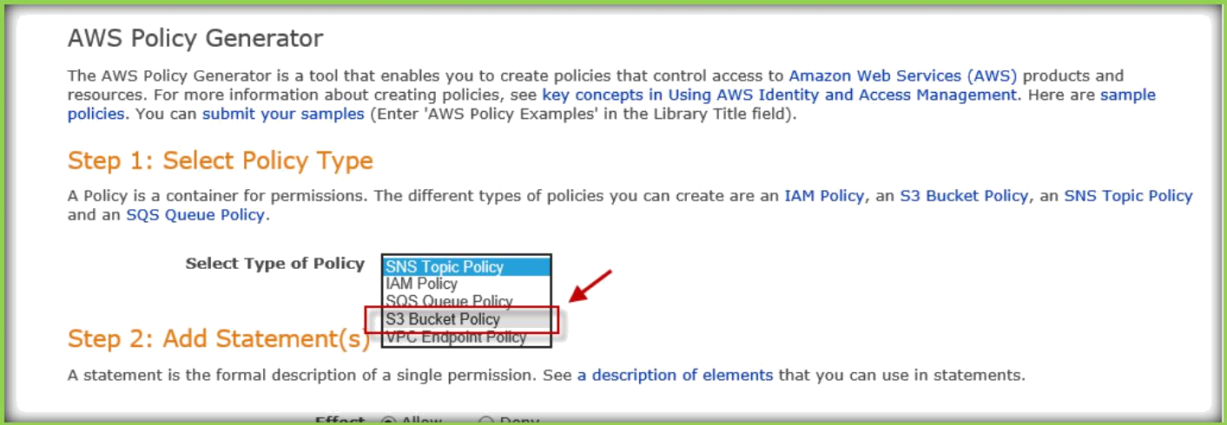
From the AWS policy generator page, choose various options to generate policy.
Choose S3 Bucket Policy from Select type of policy.

Slide 32
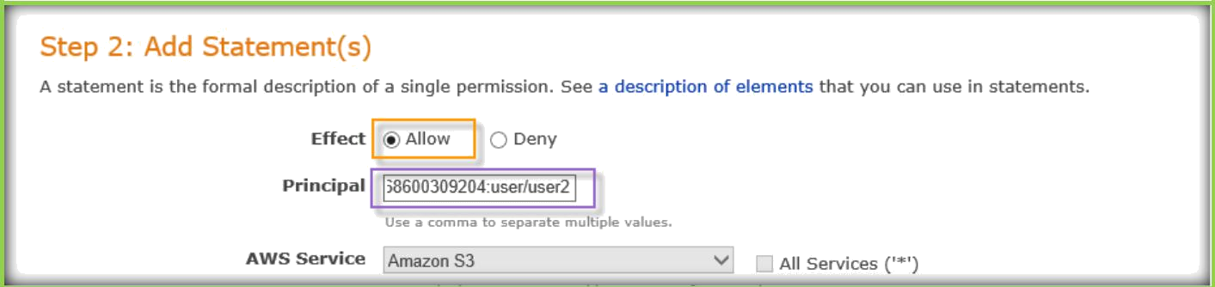
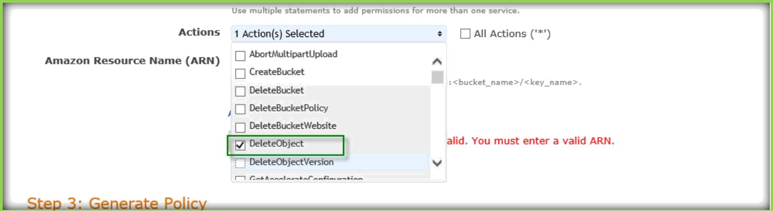
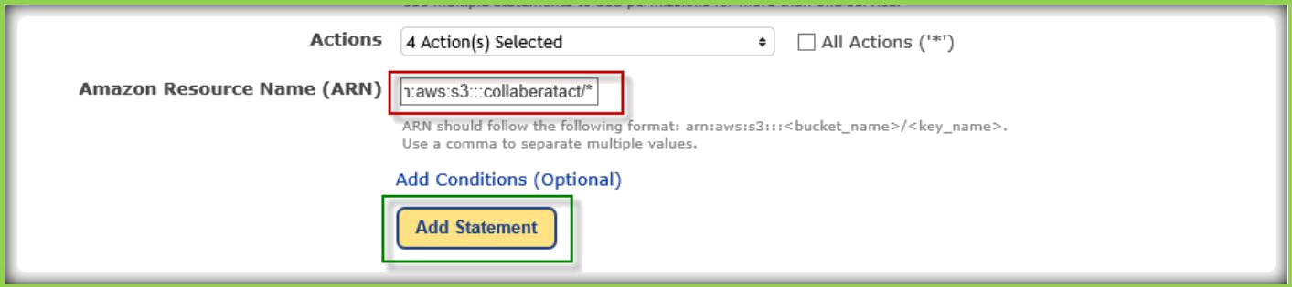
Choose Allow or Deny from Effect, then specify the AWS IAM user ARN in Principal text box.
From the Actions drop down list either choose All Actions or choose only specific options to give.
Under Amazon Resource Name (ARN) specify the S3 bucket ARN in the following format.
arn:aws:s3:::<bucket_name>/<key_name>
Once you specified choose Add statement button.

Slide 33


Then choose Generate Policy to generate S3 bucket policy.
Then a pop up window will open with JSON format code, copy the code and paste it in the AWS bucket policy page where we choose AWS policy generator option.
Once pasted, select Save to save and apply the policy.

Slide 34


To edit the policy, choose edit bucket policy option under Permissions of the bucket properties.
Existing policy will open, either you can modify code or choose AWS policy generator to create a new policy then choose save to apply
policies.

Slide 35


DELETING A BUCKET
Select your bucket and choose Delete bucket option on the top.

Slide 36

A pop up dialog box will open and ask for the bucket name to be entered to confirm the bucket deletion, then choose confirm.

